Slide 1
Sedentary = seated or resting A sedentary lifestyle = a lot of sitting around, not much exercise

Slide 2
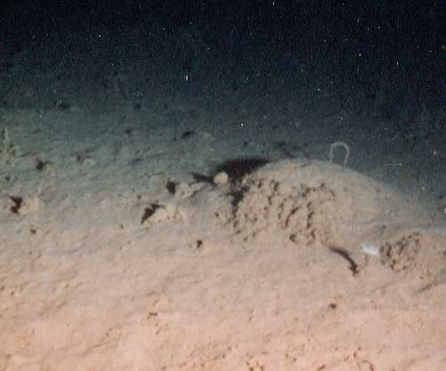
Ocean Sediments

Slide 3
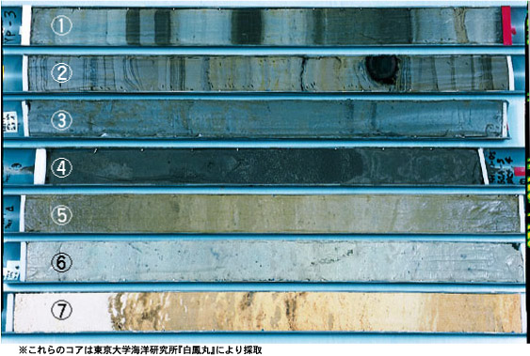
Sediment core samples from ocean floor

Slide 4
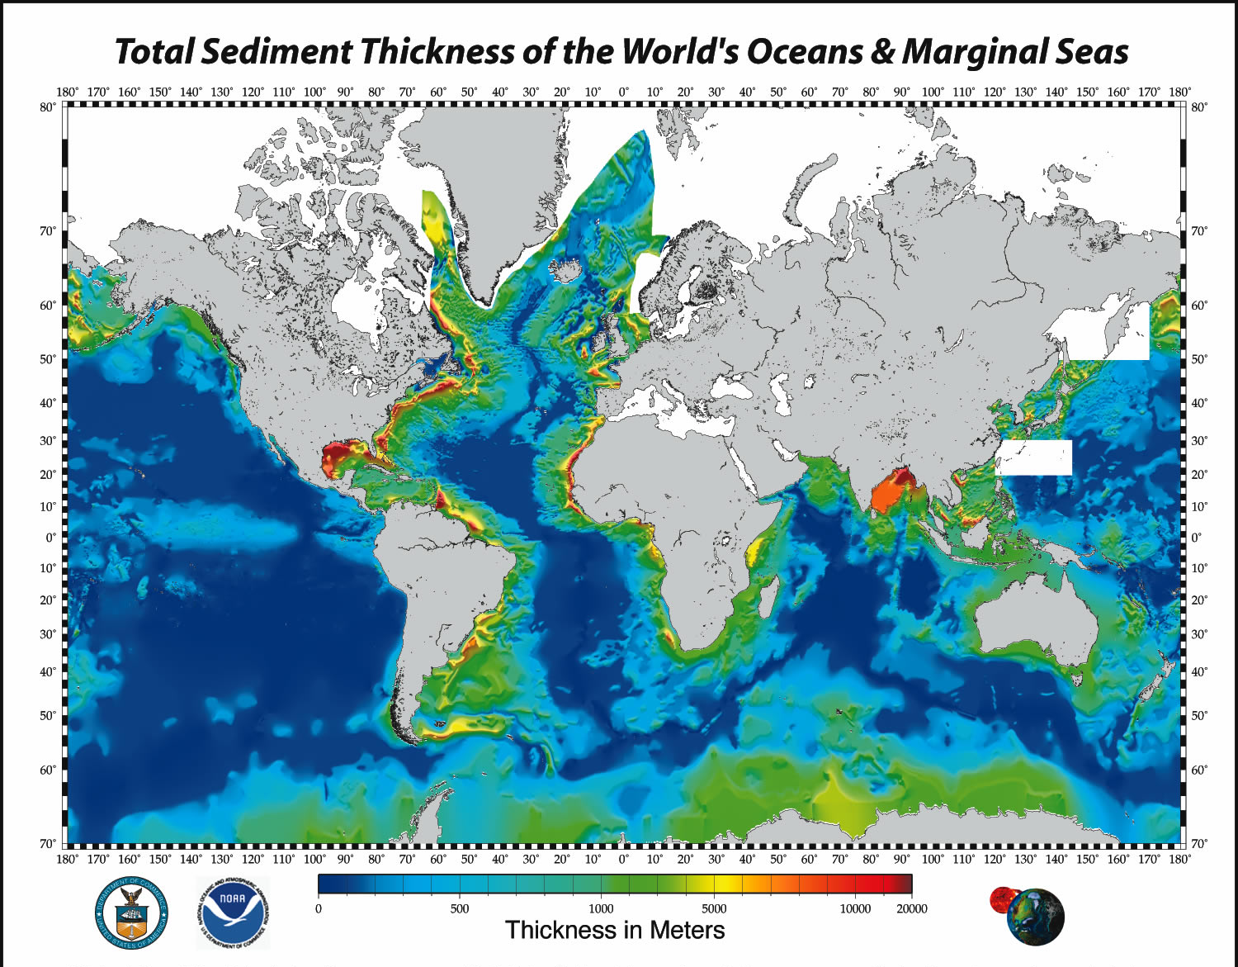

Slide 5
CLASSIFICATION OF MARINE SEDIMENTS based on Origin … know 4
70 % LITHOGENIC (carried by rivers & wind)
Rocks
Volcanogenic
Cosmogenic
70% of ocean sediment volume
30% BIOGENIC (remains of ocean organisms)
Teeth, bones, shells / “tests”, soft tissues
Covers ½ of all continental shelves
30% of ocean sediment volume

Slide 6
Thickest deposits … sediments delivered by rivers

Slide 7
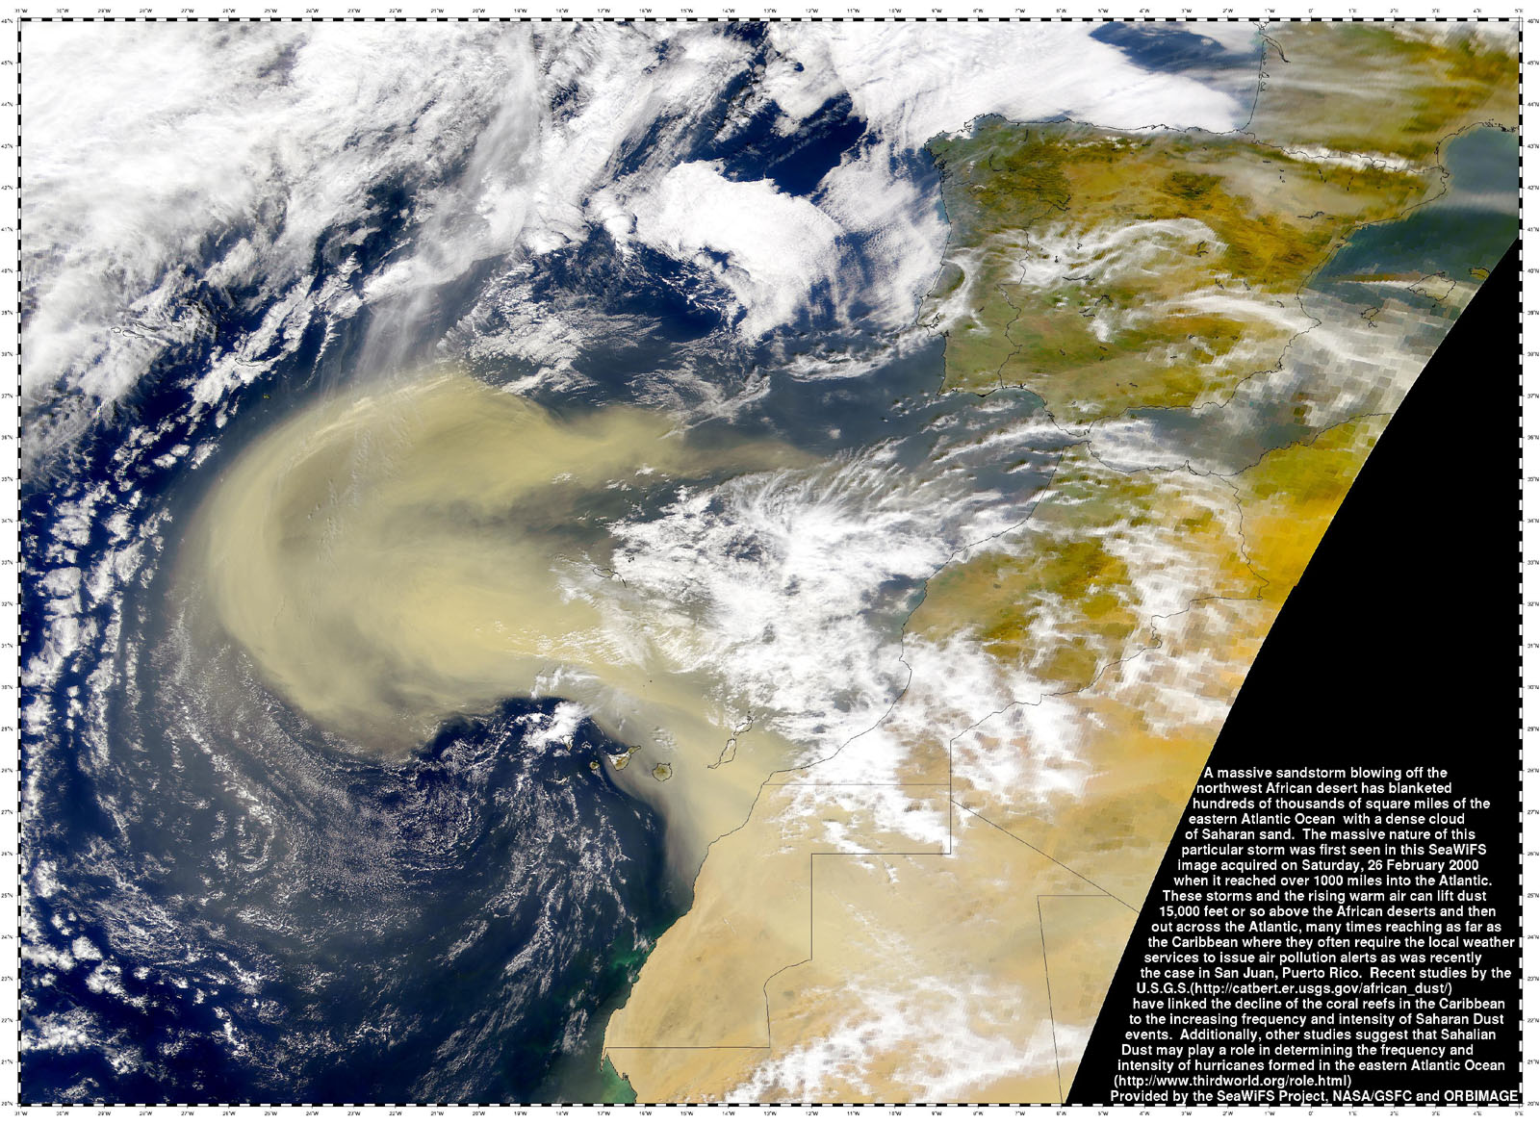
Wind
(eolian)
Sahara Dust (NASA)

Slide 8
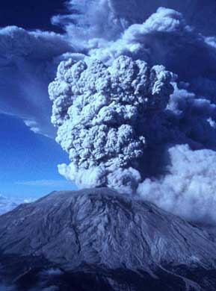
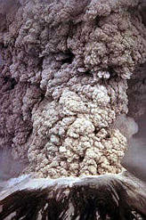
VOLCANOGENIC…
from volcanos

Slide 9
CLASSIFICATION OF MARINE SEDIMENTS based on Origin … know 4
70 % LITHOGENIC (carried by rivers & wind)
Rocks
Volcanogenic
Cosmogenic
70% of ocean sediment volume
30% BIOGENIC (remains of ocean organisms)
Teeth, bones, shells / “tests”, soft tissues
ALGAL BLOOMS
Covers ½ of all continental shelves
30% of ocean sediment volume

Slide 10
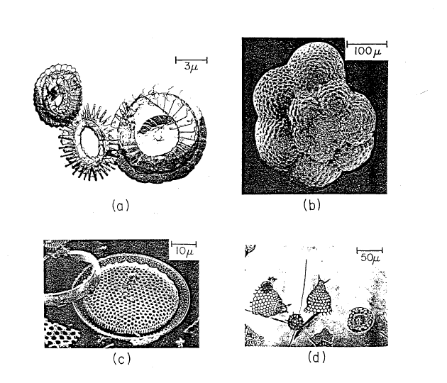
Biogenic
sediments
Coccoliths
Forams
Diatoms
Radiolarians

Slide 11
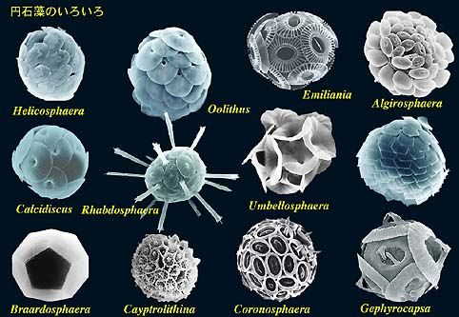
Calcareous ooze components
Coccoliths

Slide 12
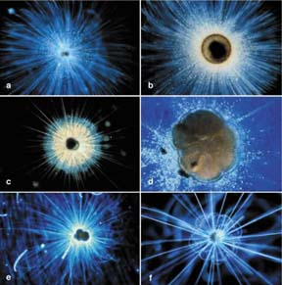
Calcareous ooze components
Forams

Slide 13
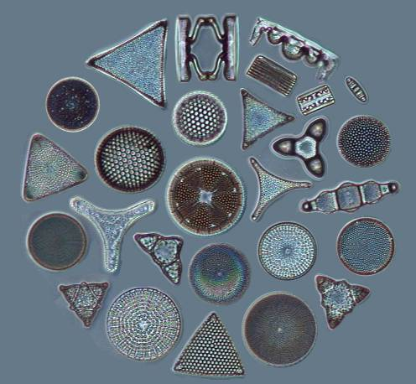
Part of the Silaceous ooze
Diatom “tests”

Slide 14
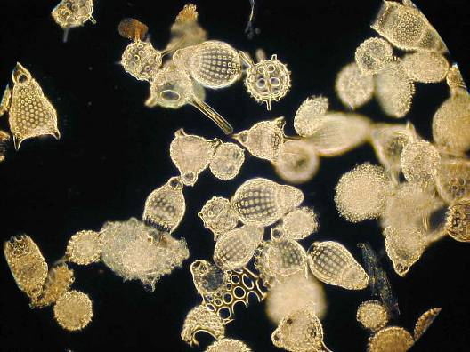
Silaceous ooze components
Radiolarian tests

Slide 15
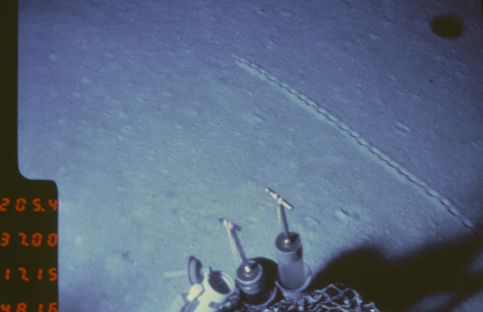
Ocean Sediments
Calcareous ooze

Slide 16
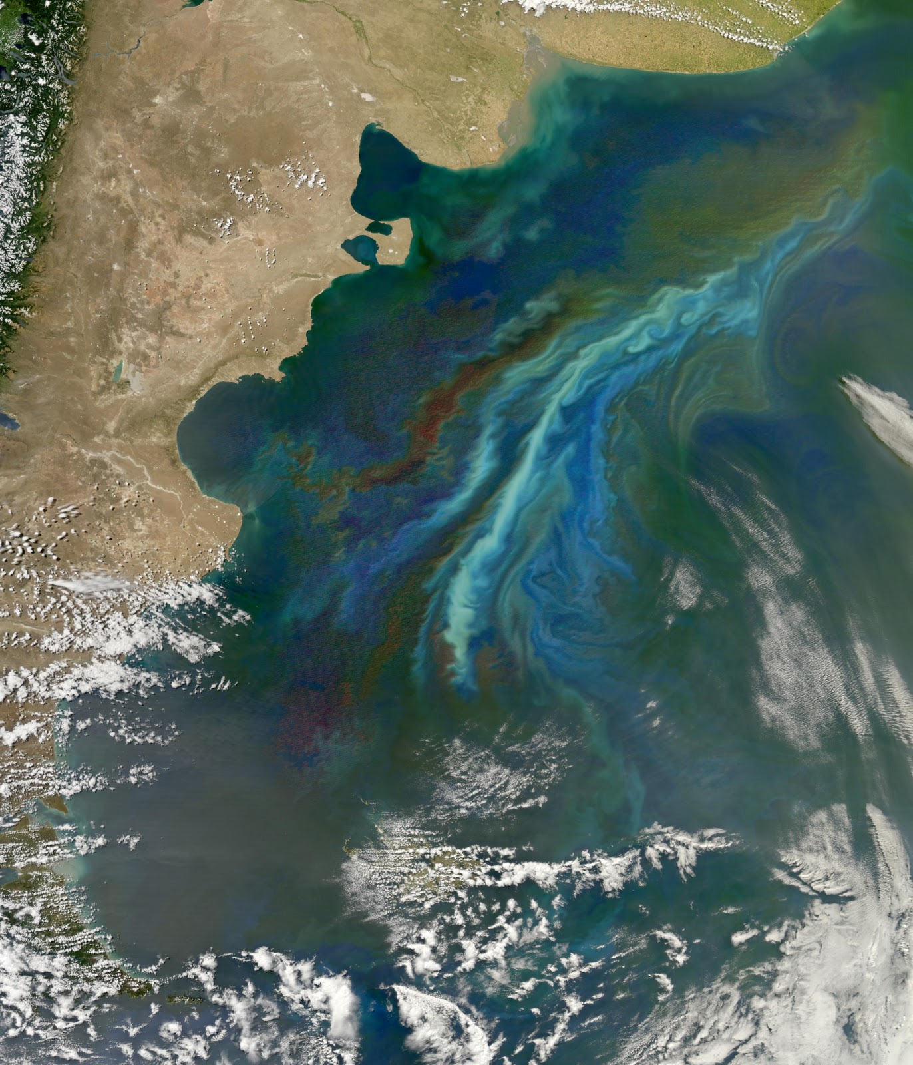
Algal Bloom (algae) Patagonia coastline

