Slide 1
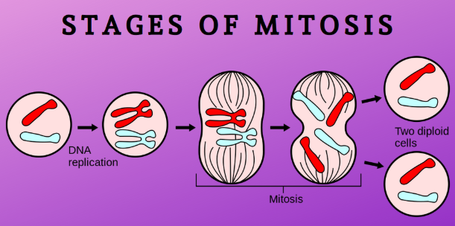

Slide 2
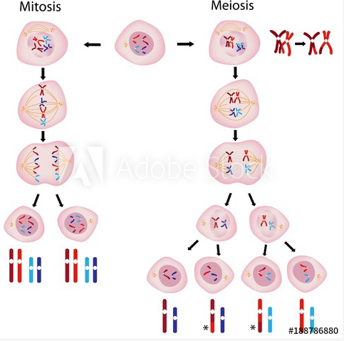
DNA

Slide 3
MEIOSIS Creating SPERM and/or EGGS Q: Why do all siblings look different from each other (and why do they look similar)? ANS: Crossing over, also called recombination Happens early in PROPHASE Chromosomes “cross over” each other, and the DNA ‘RECOMBINES’ with a new chromosome.

Slide 6
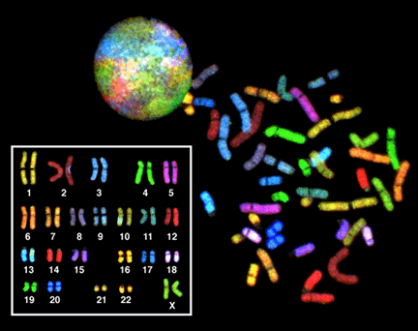
a human karyotype
A human KARYOTYPE
“CARE-ee-oh-type

Slide 7
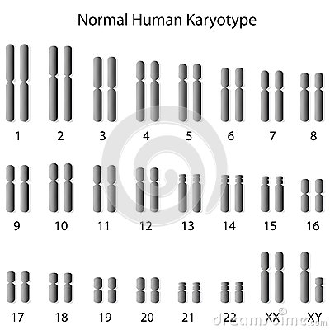

Slide 8
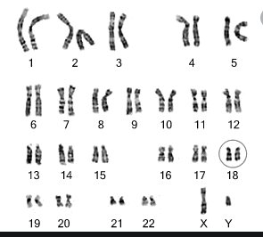

Slide 9
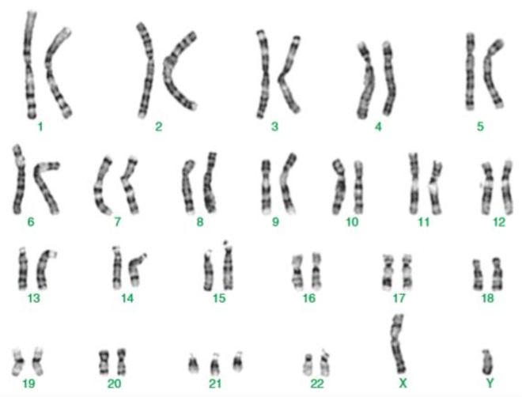

Slide 10
