Slide 1
ENZYMES Very special proteins

Slide 2
Enzymes: Biological Catalysts* *catalysts make things happen
Enzymes lower activation energy and thus speed up chemical reactions.
Reactions that might take years to happen can occur in a fraction of a second.

Slide 3
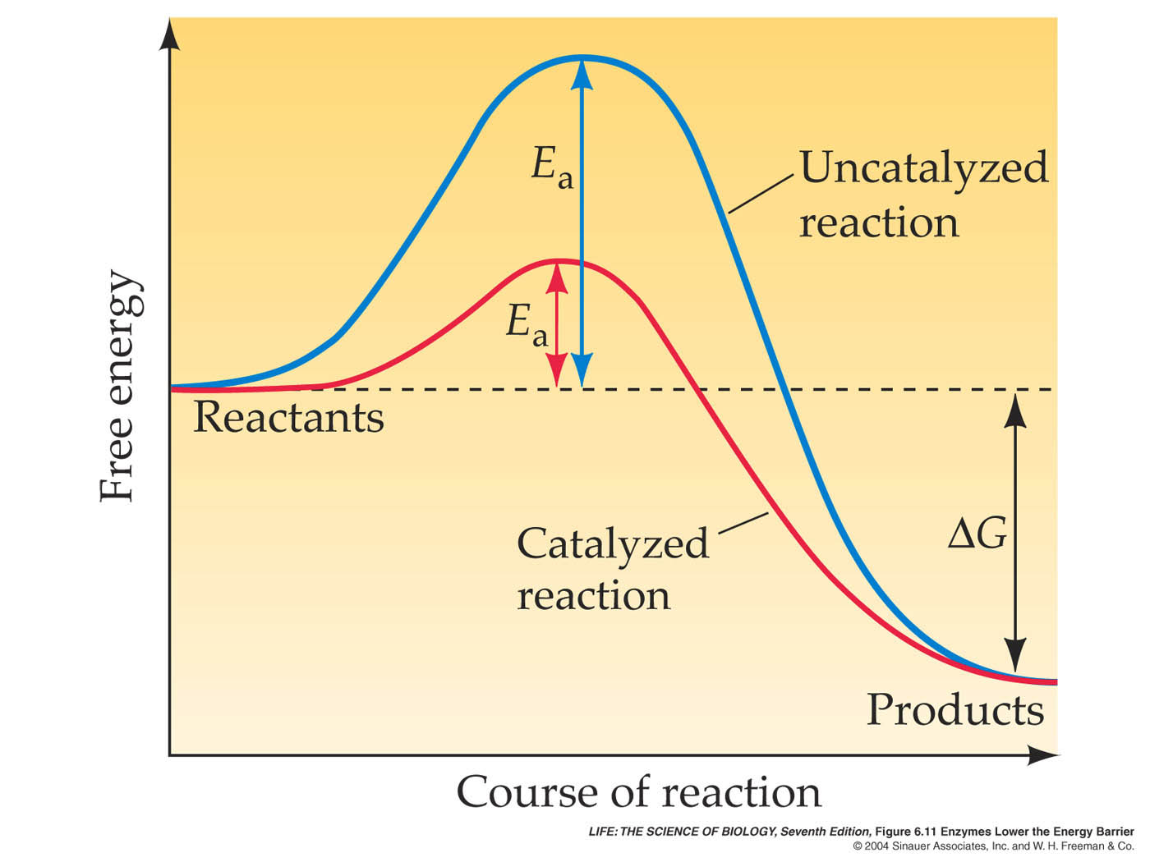
Figure 6.11 Enzymes Lower the Energy Barrier

Slide 4
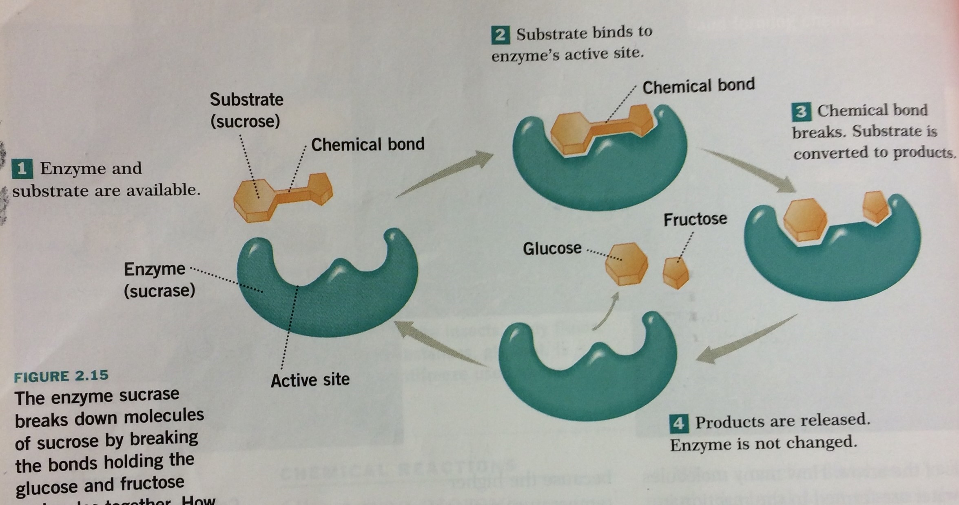

Slide 5
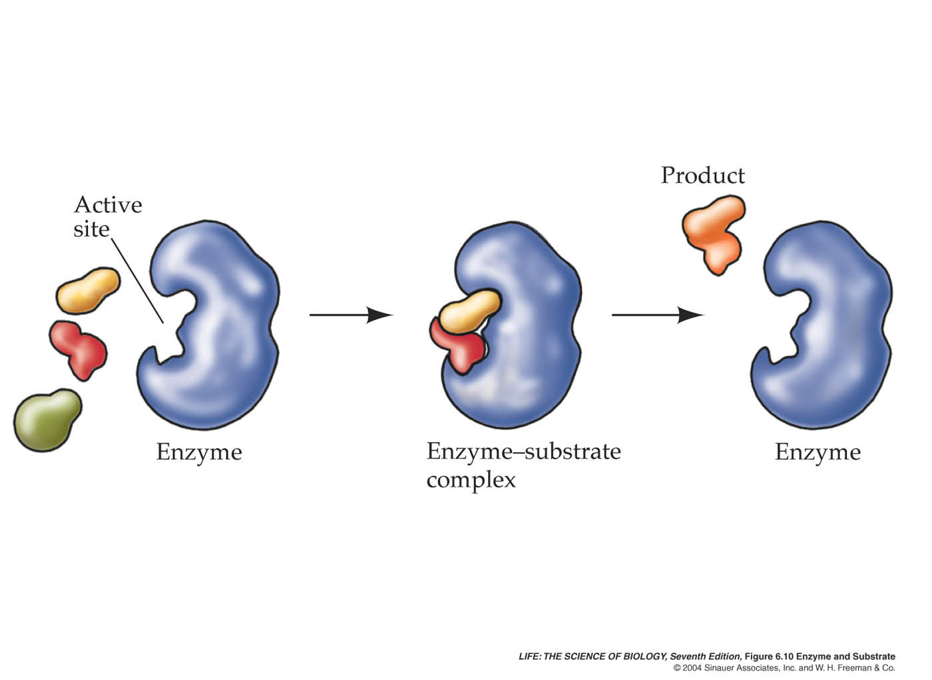
Enzymes also help to build molecules ……. Think: DEHYDRATION SYNTHESIS

Slide 6
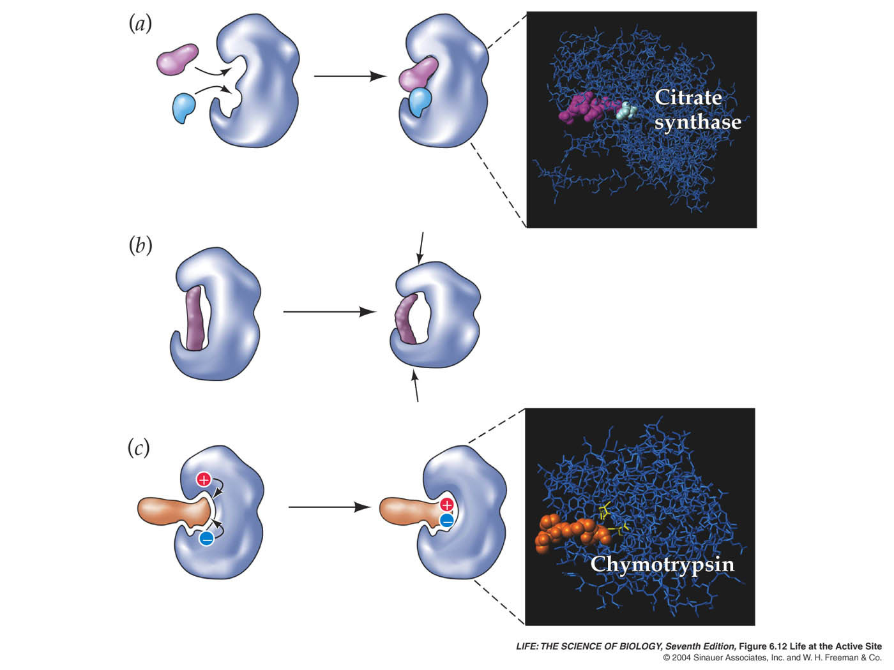
Life at the Active Site

Slide 7
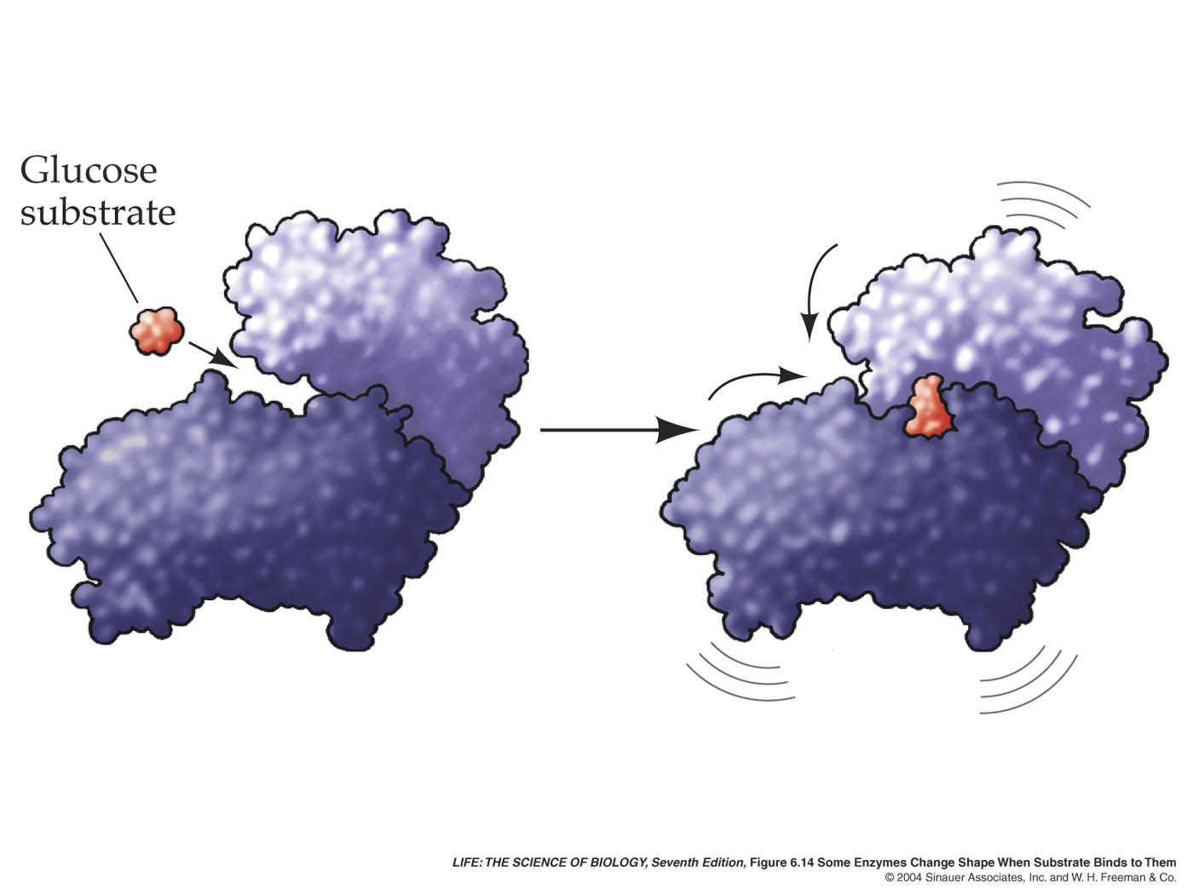
Figure 6.14 Some Enzymes Change Shape When Substrate Binds to Them

Slide 8
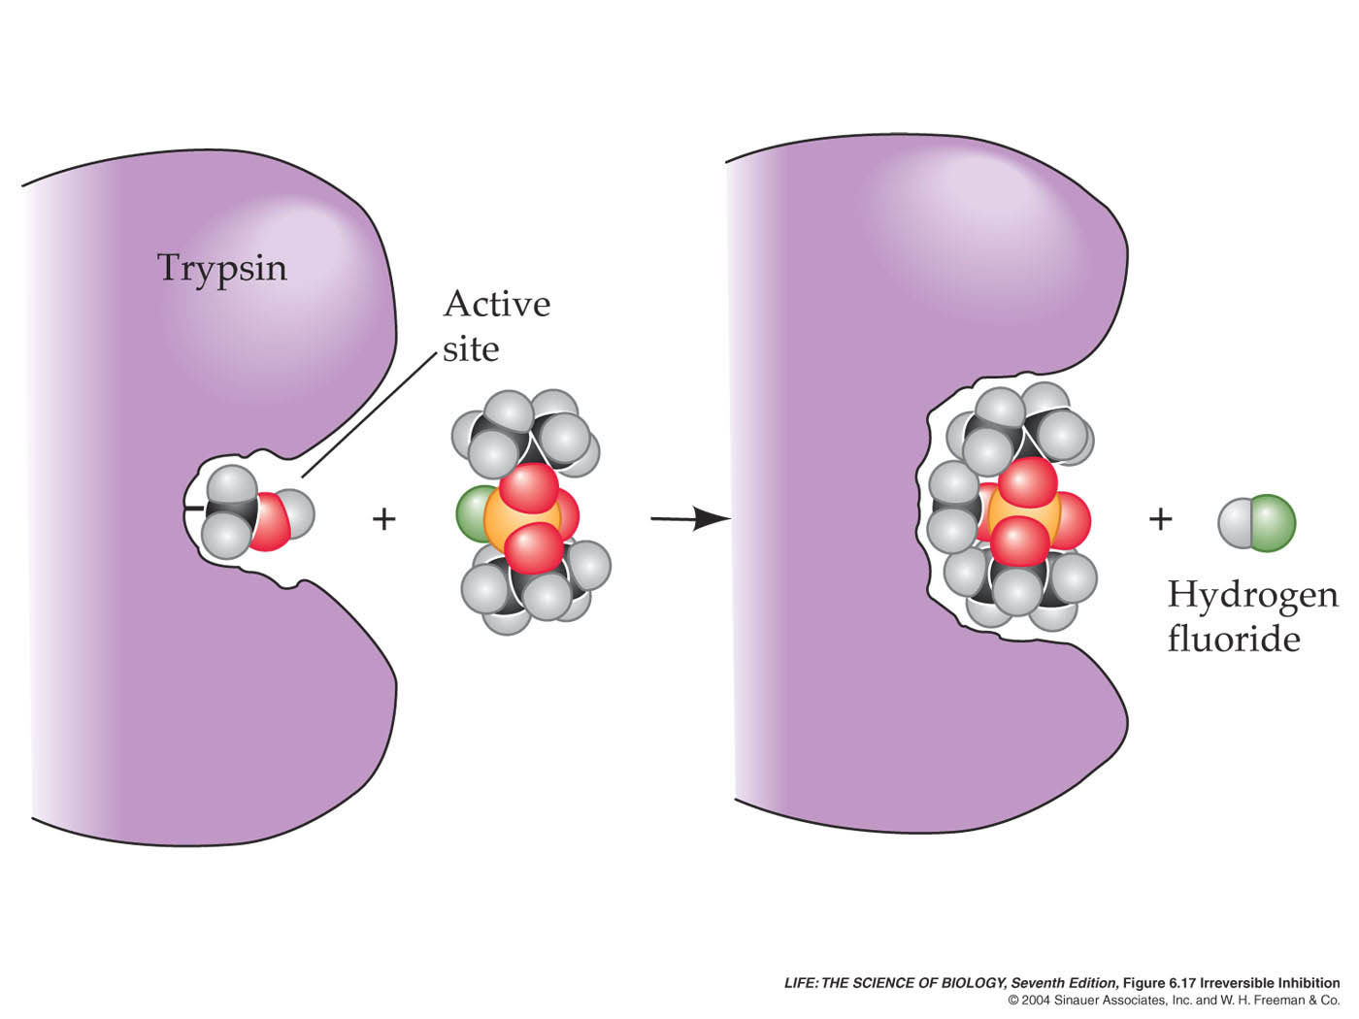
ENZYMES CAN BE BLOCKED…..DEATH
Example: Sarin nerve gas

Slide 9
Google: Pearson Lab Bench…. Choose Lab 2, Enzyme Catalysis. STOP when you see “Design the Experiment”.
IN COMPLETE SENTENCES… ANSWER THE FOLLOWING:
What is the enzyme in this lab?
What is the substrate in this lab?
What are the products created after the reaction occurs?
What is the chemical reaction that is occurring?
Which is the larger molecule, enzyme or substrate?
Why do enzymes ONLY work on specific substrates? Explain fully.

