Slide 1
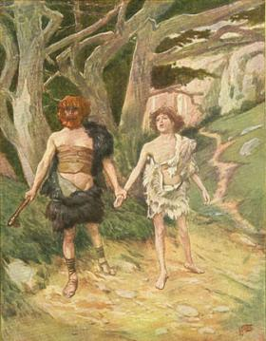
Cain says, “Right this way, bro.” Genesis, Chapter 4

Slide 2
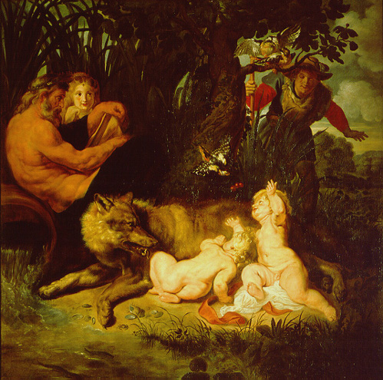
Romulus and Remus – in happier times

Slide 3
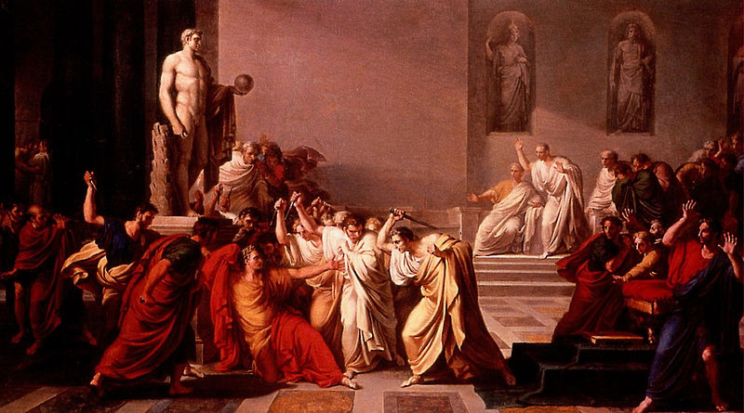
Assassination of Julius Caesar
44 B.C.

Slide 4
In China…300 A.D.
A woman kills her husband…

