Slide 1
Chapter 15
Nonrenewable Energy

Slide 2
Chapter Overview Questions
What are the advantages and disadvantages of conventional oil and nonconventional heavy oils?
What are the advantages and disadvantages of natural gas?
What are the advantages and disadvantages of coal and the conversion of coal to gaseous and liquid fuels?

Slide 3
Chapter Overview Questions (cont’d)
What are the advantages and disadvantages of conventional nuclear fission, breeder nuclear fission, and nuclear fusion?

Slide 4
Illustrated History of Energy
http://science.howstuffworks.com/environmental/energy/timeline-energy-history.htm

Slide 5
Core Case Study: How Long Will the Oil Party Last?
Saudi Arabia could supply the world with oil for about 10 years.
The Alaska’s North Slope could meet the world oil demand for 6 months (U.S.: 3 years).
Alaska’s Arctic National Wildlife Refuge would meet the world demand for 1-5 months (U.S.: 7-25 months).

Slide 6
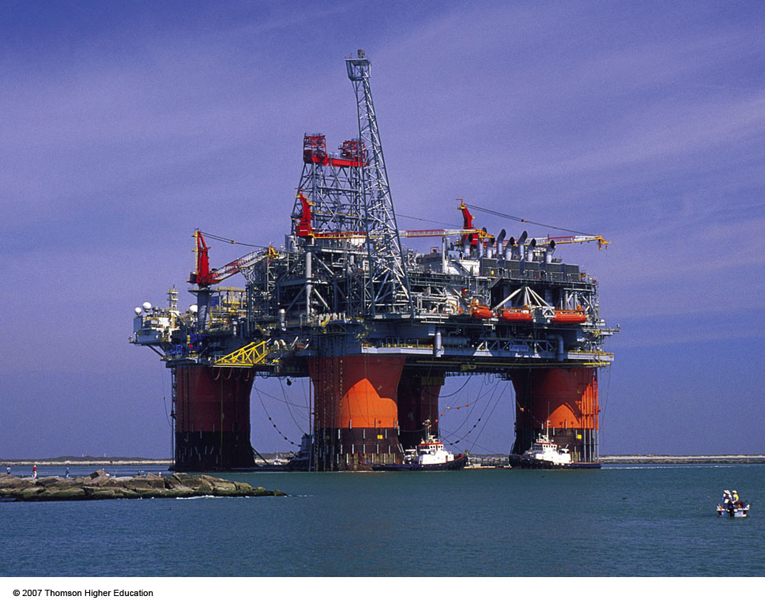
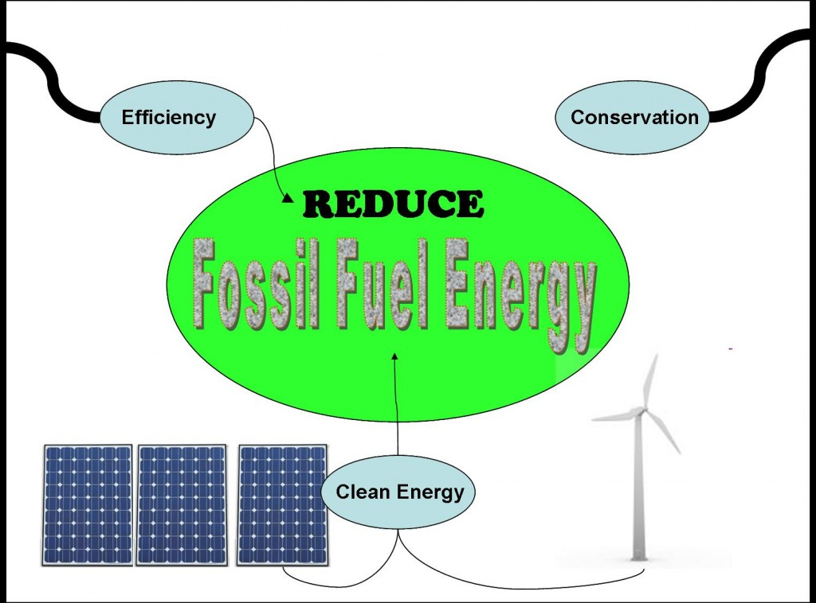
Core Case Study: How Long Will the Oil Party Last?
We have three options:
Look for more oil.
Use or waste less oil.
Use something else.
Figure 16-1

Slide 7
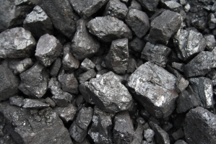
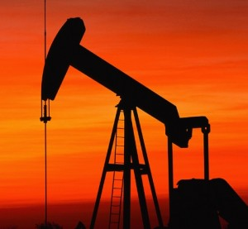
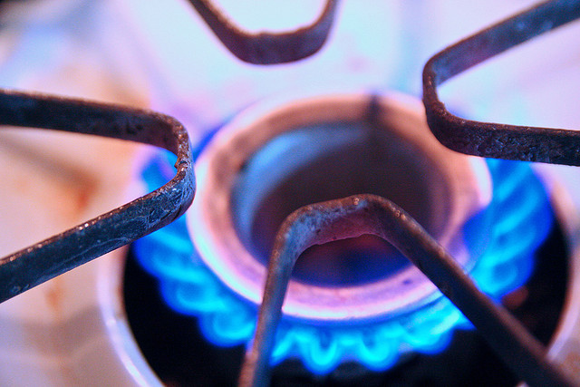

Slide 8
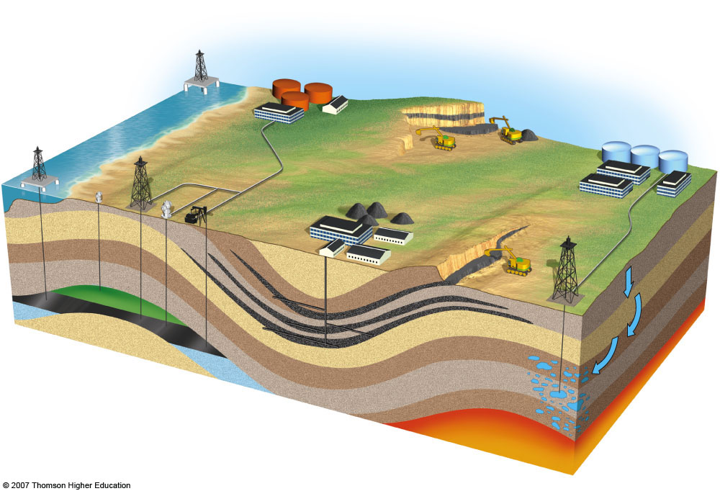
Oil and natural gas
Floating oil drilling platform
Oil storage
Coal
Geothermal energy
Contour strip mining
Oil drilling platform on legs
Hot water storage
Oil well
Gas well
Pipeline
Geothermal power plant
Valves
Mined coal
Pump
Area strip mining
Pipeline
Drilling tower
Impervious rock
Underground coal mine
Oil
Natural gas
Water
Water is heated and brought up as dry steam or wet steam
Water
Water penetrates down through the rock
Coal seam
Hot rock
Magma
Fig. 16-2, p. 357
Notes:
Figure 16.2
Natural capital: important nonrenewable energy resources that can be removed from the earth’s crust are coal, oil, natural gas, and some forms of geothermal energy. Nonrenewable uranium ore is also extracted from the earth’s crust and processed to increase its concentration of uranium-235, which can serve as a fuel in nuclear reactors to produce electricity.

Slide 9
TYPES OF ENERGY RESOURCES
Nonrenewable: Renewable:
_______ ___________
Coal Hydropower
Natural Gas ___________
_______ Solar
________

Slide 10
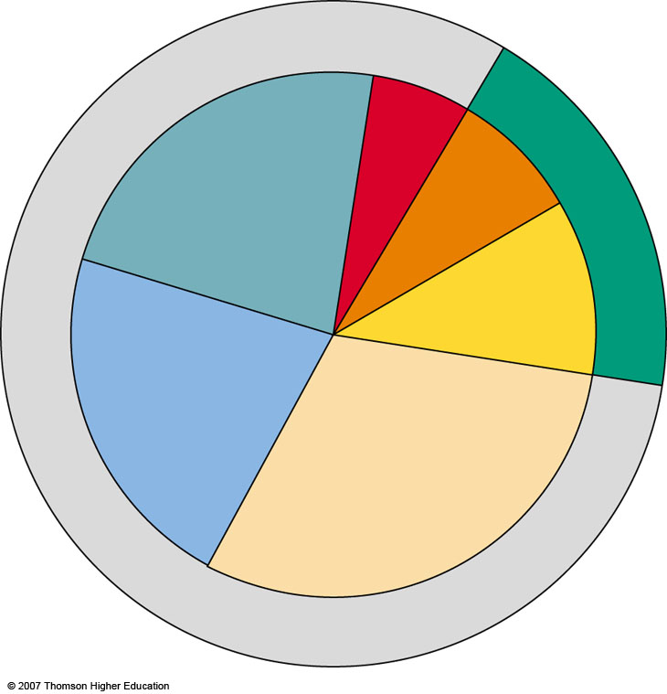
World
Nuclear power 6%
Hydropower, geothermal, solar, wind
7%
Natural gas
21%
RENEWABLE 18%
Biomass 11%
Coal 22%
Oil 33%
NONRENEWABLE 82%
Fig. 16-3a, p. 357
Notes:
Figure 16.3
Natural capital: commercial energy use by source for the world (left) and the United States (right) in 2004. Commercial energy amounts to only 1% of the energy used in the world; the other 99% is direct solar energy received from the sun and is not sold in the marketplace. (Data from U.S. Department of Energy, British Petroleum, Worldwatch Institute, and International Energy Agency)

Slide 11
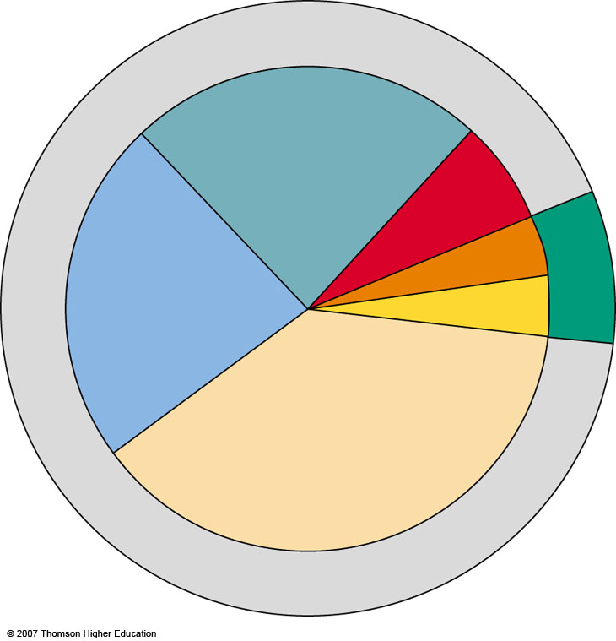
United States
Hydropower geothermal, solar, wind 3%
Natural gas 23%
Nuclear power 8%
RENEWABLE 8%
Coal 23%
Biomass 4%
Oil 39%
NONRENEWABLE 93%
Fig. 16-3b, p. 357
Notes:
Figure 16.3
Natural capital: commercial energy use by source for the world (left) and the United States (right) in 2004. Commercial energy amounts to only 1% of the energy used in the world; the other 99% is direct solar energy received from the sun and is not sold in the marketplace. (Data from U.S. Department of Energy, British Petroleum, Worldwatch Institute, and International Energy Agency)

Slide 12
Net Energy Ratios
Total energy _________ : energy _______ to produce it
Example: 10 units of energy in oil produced, use 8 units of energy to produce it
10:8 = 1.25
The higher the net energy ratio, the greater the net energy available. Ratios < 1 indicate a net energy _________.
Figure 16-4

Slide 13
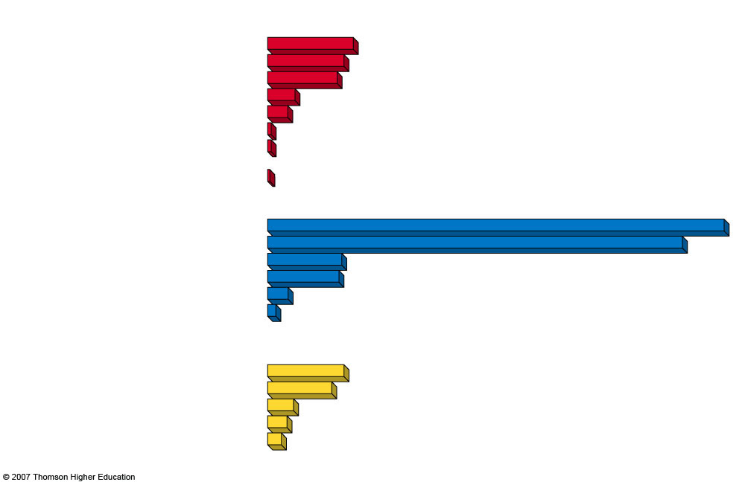
Space Heating
Passive solar
5.8
Natural gas
4.9
Oil
4.5
Active solar
1.9
Coal gasification
1.5
Electric resistance heating (coal-fired plant)
0.4
Electric resistance heating (natural-gas-fired plant)
0.4
Electric resistance heating (nuclear plant)
0.3
High-Temperature Industrial Heat
Surface-mined coal
28.2
Underground-mined coal
25.8
Natural gas
4.9
Oil
4.7
Coal gasification
1.5
Direct solar (highly concentrated by mirrors, heliostats, or other devices)
0.9
Transportation
Natural gas
4.9
Gasoline (refined crude oil)
4.1
Biofuel (ethyl alcohol)
1.9
Coal liquefaction
1.4
Oil shale
1.2
Fig. 16-4, p. 358
Notes:
Figure 16.4
Science: Net energy ratios for various energy systems over their estimated lifetimes: the higher the net energy ratio, the greater the net energy available. QUESTION: Based on these data which three resources in each category should we be using? Compare this with the major resources we are actually using as shown in Figure 16-3. (Data from U.S. Department of Energy and Colorado Energy Research Institute, Net Energy Analysis, 1976; and Howard T. Odum and Elisabeth C. Odum, Energy Basis for Man and Nature, 3rd ed., New York: McGraw-Hill, 1981)

Slide 14
OIL
Crude oil (____________) is a thick liquid containing hydrocarbons that we extract from underground deposits and separate into products such as gasoline, heating oil and asphalt.
Only 35-50% can be economically recovered from a deposit.
As prices rise, about 10-25% more can be recovered from expensive techniques.
Burning oil for transportation accounts for 43% of global CO₂ emissions.

Slide 15
OIL
Refining crude oil:
Based on boiling points, components are removed at various layers in a giant column.
The most volatile components with the lowest boiling points are removed at the top.
Figure 16-5

Slide 16
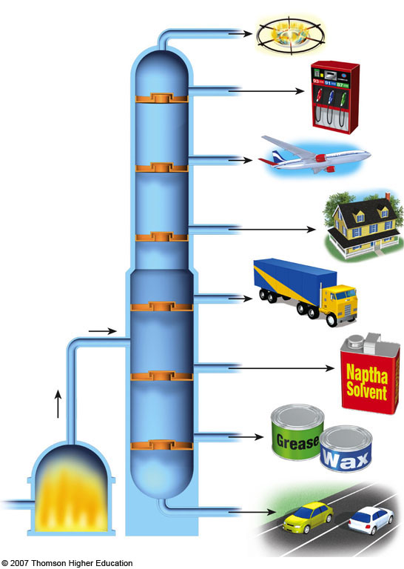
Gases
Gasoline
Aviation fuel
Heating oil
Diesel oil
Naptha
Heated crude oil
Grease and wax
Furnace
Asphalt
Fig. 16-5, p. 359
Notes:
Figure 16.5
Science: refining crude oil. Based on their boiling points, components are removed at various levels in a giant distillation column. The most volatile components with the lowest boiling points are removed at the top of the column.

Slide 17
Case Study: U.S. Oil Supplies
The U.S. – the world’s largest oil user – has only 2.9% of the world’s proven oil reserves.
U.S oil production peaked in 1974 (halfway production point).
About 60% of US oil imports goes through refineries in hurricane-prone regions of the Gulf Coast.

Slide 18
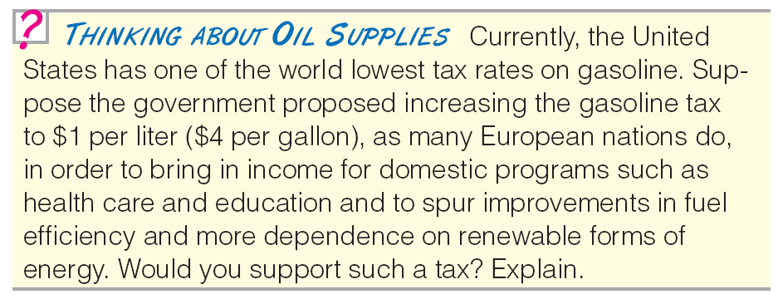

Slide 19
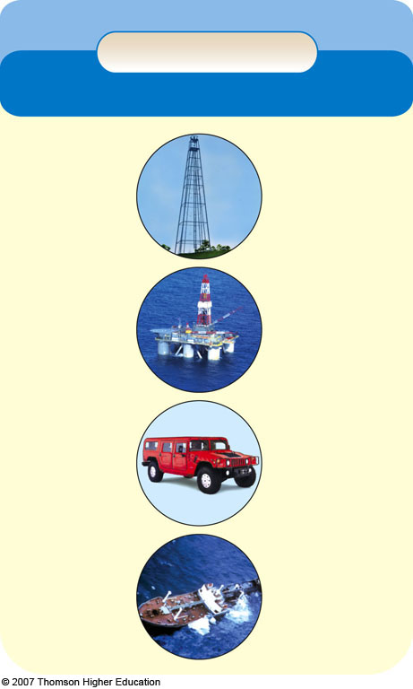
Trade-Offs
Conventional Oil
Advantages
Disadvantages
Ample supply for 42–93 years
Need to find substitutes within 50 years
Low cost (with huge subsidies)
Artificially low price encourages waste and discourages search for alternatives
High net energy yield
Easily transported within and between countries
Air pollution when burned
Low land use
Technology is well developed
Releases CO₂ when burned
Efficient distribution system
Moderate water pollution
Fig. 16-7, p. 363
Notes:
Figure 16.7
Trade-offs: advantages and disadvantages of using conventional crude oil as an energy resource. QUESTION: Which single advantage and which single disadvantage do you think are the most important?

Slide 20
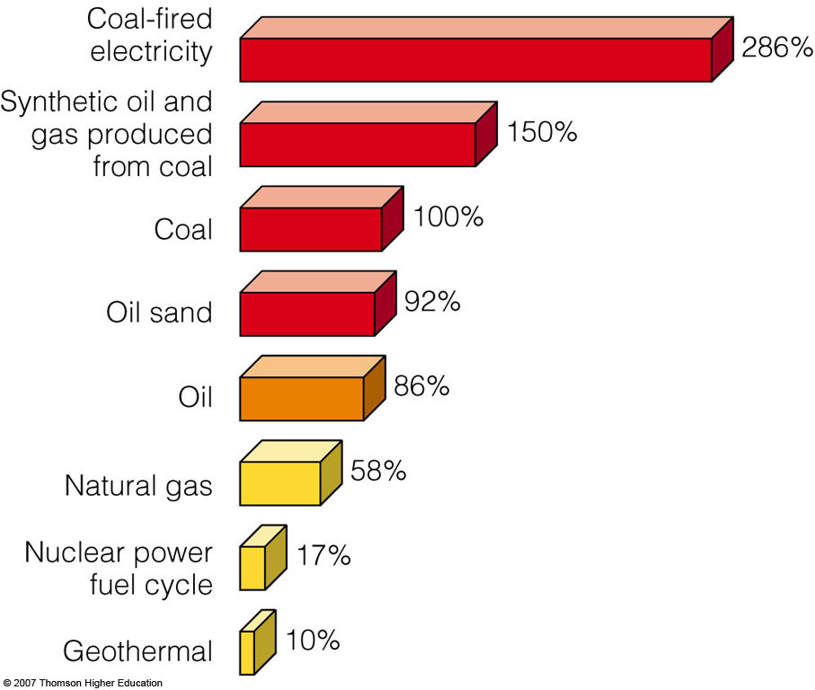
CO₂ emissions per unit of energy produced for various energy resources.
Figure 16-8

Slide 21
Oil Sand
Mixture of ______, ______, _______, and a combustible organic material called _________, a thick heavy oil with a high sulfur content.
Found near earth’s surface
Canada has ¾ of the oil sand reserves
Some in Utah

Slide 22
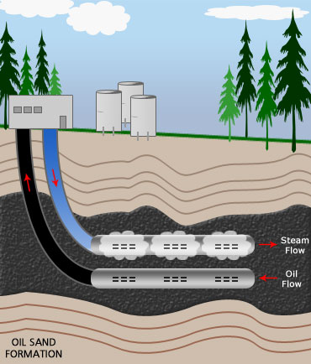
Alberta’s Oil Sand
Most of the heavy, tar-like oil called bitumen found in Alberta's oilsands is too deep in the earth to be mined.
The newest technique for tapping that deep resource is called Steam Assisted Gravity Drainage.
Two parallel wells are drilled into the bottom of the reservoir. Steam is injected into the top well and the heat melts the bitumen, which drains by gravity into the lower well.
Because the water is mostly recycled, the process takes less than a barrel of water for every barrel of oil produced. That compares to between two and 4½ barrels of water needed to produce one barrel of oil when bitumen is mined.
http://www.cbc.ca/blueprintalberta/features/oilsands.html

Slide 23
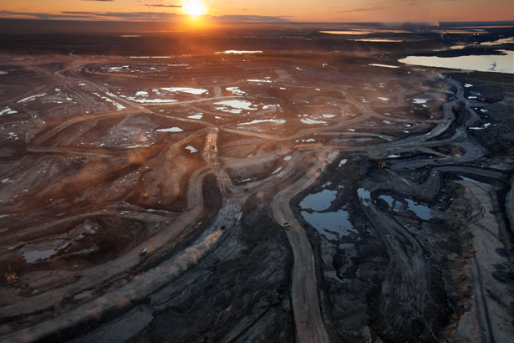
Tar sands
tar sands
Once considered too expensive, as well as too damaging to the land, exploitation of Alberta's oil sands is now a gamble worth billions. (NationalGeographic.com)

Slide 24
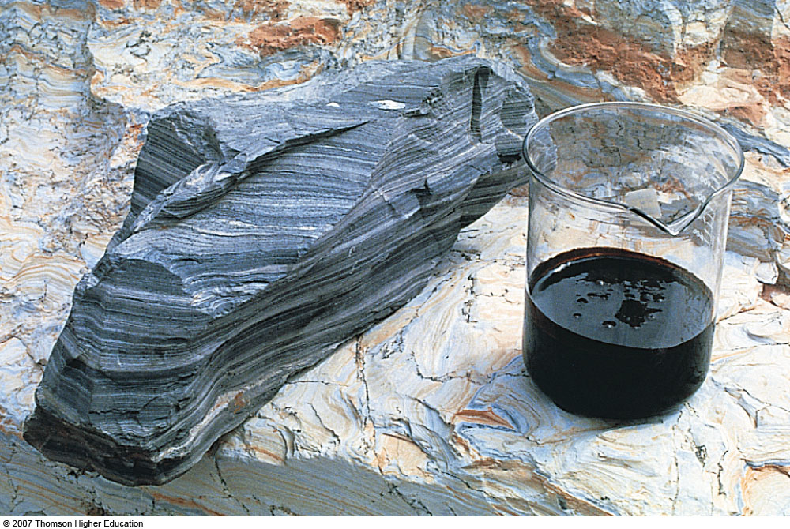
Oil Shales
Oil shales contain a solid combustible mixture of hydrocarbons called _________.
Buried deep in rock formations in western US - Wyoming, Utah, Colorado
Figure 16-9

Slide 25
Heavy Oils from Oil Sand and Oil Shale: Will Sticky Black Gold Save Us?
Heavy and tarlike oils from oil sand and oil shale could supplement conventional oil, but there are environmental problems.
High _________ content.
Extracting and processing produces:
Toxic _________
Uses and contaminates larges volumes of water
Requires large inputs of ___________ ________which reduces net energy yield.

Slide 26
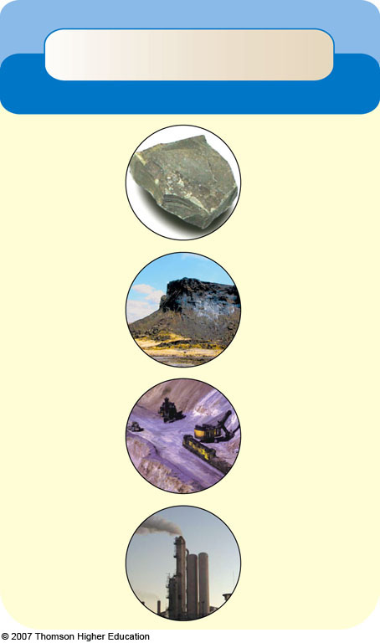
Trade-Offs
Heavy Oils from Oil Shale and Oil Sand
Advantages
Disadvantages
Moderate cost (oil sand)
High cost (oil shale)
Large potential supplies, especially oil sands in Canada
Low net energy yield
Large amount
of water needed
for processing
Easily transported within and between countries
Severe land disruption
Severe water pollution
Efficient distribution system in place
Air pollution when burned
Technology is well developed
CO₂ emissions when burned
Fig. 16-10, p. 365
Notes:
Figure 16.10
Trade-offs: advantages and disadvantages of using heavy oils from oil sand and oil shale as energy resources. QUESTION: Which single advantage and which single disadvantage do you think are the most important?

Slide 27
NATURAL GAS
A mixture of gases which is mostly _________, with smaller amounts of _________, __________, and ___________.
Lies above most reservoirs of crude oil
When a natural gas-field is tapped, gasses are liquefied and removed as ___________ petroleum gas (LPG).
Unconventional natural gas: Coal bed methane gas and _________ _________(bubbles of methane trapped in ice crystals deep under the arctic permafrost and beneath deep-ocean sediments)

Slide 28
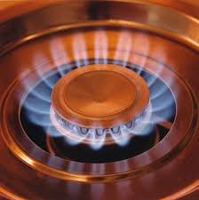
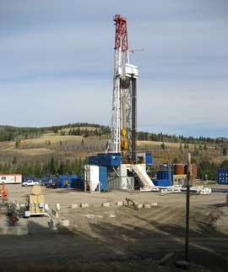
NATURAL GAS
Russia and Iran have almost half of the world’s reserves of conventional gas, and global reserves should last 62-125 years.
Natural gas is versatile and clean-burning fuel, but it releases the greenhouse gases _______________(when burned) and _________ (from leaks) into the troposphere.

Slide 29
Fracking
Hydraulic fracturing is a process of digging into the earth over a mile inside and attempting to dig up natural gas. They put a million gallons of water filled with chemicals inside that help extract the natural gas. The problem is that many people, including children are becoming ill from the chemicals that they are ingesting from water contamination.
Fracking Fracking Song

Slide 30
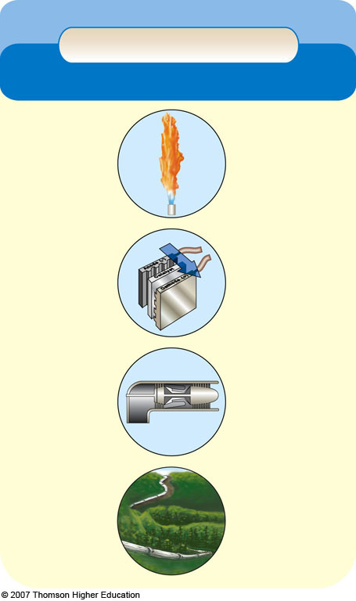
Trade-Offs
Conventional Natural Gas
Advantages
Disadvantages
Ample supplies (125 years)
Nonrenewable resource
High net energy yield
Releases CO₂ when burned
Low cost (with huge subsidies)
Methane (a greenhouse gas) can leak from pipelines
Less air pollution than other fossil fuels
Lower CO₂ emissions than other fossil fuels
Difficult to transfer from one country to another
Moderate environmental impact
Shipped across ocean as highly explosive LNG
Easily transported by pipeline
Sometimes burned off and wasted at wells because of low price
Low land use
Good fuel for fuel cells and gas turbines
Requires pipelines
Fig. 16-11, p. 368
Notes:
Figure 16.11
Trade-offs: advantages and disadvantages of using conventional natural gas as an energy resource. QUESTION: Which single advantage and which single disadvantage do you think are the most important?

Slide 31
COAL
Coal is a solid fossil fuel that is formed in several stages as the buried remains of land plants that lived 300-400 million years ago.
Mostly _________ with small amounts of _________
When burned releases _____________, _____________, _________, and radioactive materials
Coal burned in power plants produces 50% of electricity in US
Anthracite coal is most desirable because of _____ ________ content
Figure 16-12

Slide 32
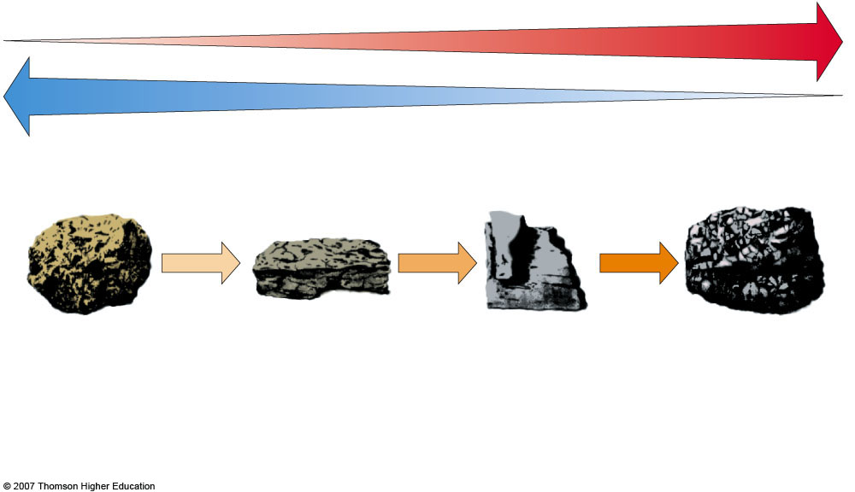
Increasing heat and carbon content
Increasing moisture content
Peat (not a coal)
Lignite (brown coal)
Bituminous (soft coal)
Anthracite (hard coal)
Heat
Heat
Heat
Pressure
Pressure
Pressure
Partially decayed plant matter in swamps and bogs; low heat content
Low heat content; low sulfur content; limited supplies in most areas
Extensively used as a fuel because of its high heat content and large supplies; normally has a high sulfur content
Highly desirable fuel because of its high heat content and low sulfur content; supplies are limited in most areas
Fig. 16-12, p. 368
Notes:
Figure 16.12
Natural capital: stages in coal formation over millions of years. Peat is a soil material made of moist, partially decomposed organic matter. Lignite and bituminous coal are sedimentary rocks, whereas anthracite is a metamorphic rock (Figure 15-8, p. 343). QUESTION: Are there coal deposits near where you live or go to school?

Slide 33
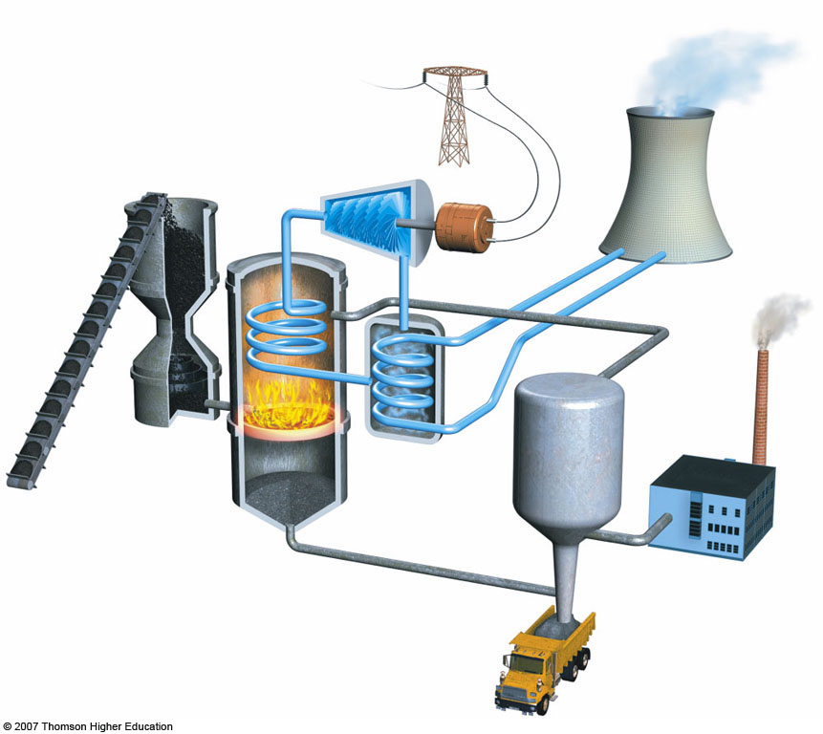
Waste heat
Cooling tower transfers waste heat to atmosphere
Coal bunker
Turbine
Generator
Cooling loop
Stack
Pulverizing mill
Condenser
Filter
Boiler
Toxic ash disposal
Coal power plant animation
Fig. 16-13, p. 369
Notes:
Figure 16.13
Science: Coal-burning power plant. Heat produced by burning pulverized coal in a furnace boils water to produce steam that spins a turbine to produce electricity. The steam is cooled, condensed, and returned to the furnace for reuse. A large cooling tower transfers waste heat to the troposphere. The largest coal-burning power plant in the United States in Indiana burns 23 metric tons (25 tons) of coal per minute or three 100-car trainloads of coal per day and produces 50% more electric power than the Hoover Dam. QUESTION: Is there a coal-burning power plant near where you live or go to school?

Slide 34
COAL
Coal is the most abundant fossil fuel, but compared to oil and natural gas it is not as versatile, has a high environmental impact, and releases much more CO₂ into the troposphere.
The U.S. has 27% of the world’s proven coal reserves, followed by Russia (17%), and China (13%).
In 2005, China and the U.S. accounted for 53% of the global coal consumption.

Slide 35
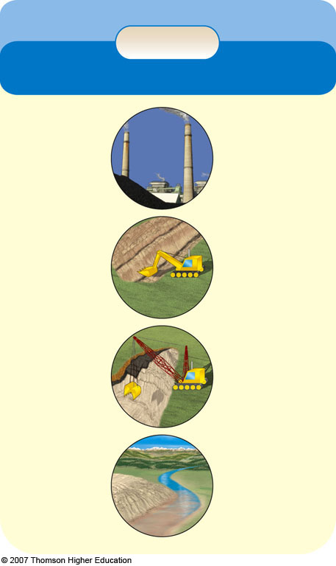
Trade-Offs
Coal
Advantages
Disadvantages
Ample supplies (225–900 years)
Severe land disturbance, air pollution, and water pollution
High net energy yield
High land use (including mining)
Low cost
(with huge subsidies)
Severe threat to human health
Well-developed mining and combustion technology
High CO₂ emissions when burned
Air pollution can be reduced with improved technology (but adds to cost)
Releases radioactive particles and toxic mercury into air
Fig. 16-14, p. 370
Notes:
Figure 16.14
Trade-offs: advantages and disadvantages of using coal as an energy resource. QUESTION: Which single advantage and which single disadvantage do you think are the most important?

Slide 36
Synfuels
Coal can be converted into _________ _________ _______ (SNG or syngas) and liquid fuels (such as methanol or synthetic gasoline) that burn cleaner (fewer air pollutants) than coal.
Costs are high.
Burning them adds more CO₂ to the troposphere than burning coal.
Since CO₂ is not regulated as an air pollutant and costs are high, U.S. coal-burning plants are unlikely to invest in coal gasification.

Slide 37
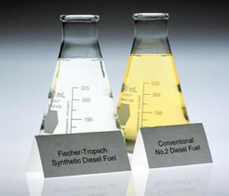
Australia's synfuel

Slide 38
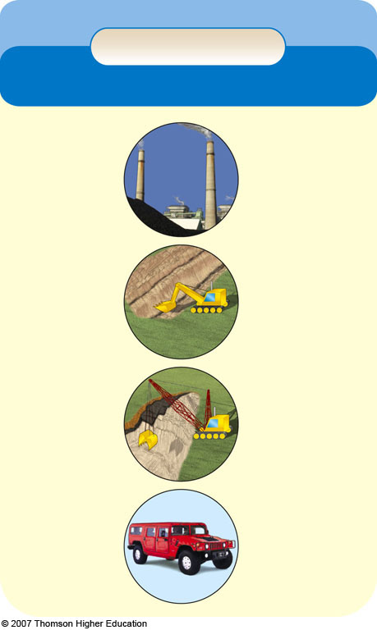
Trade-Offs
Synthetic Fuels
Advantages
Disadvantages
Large potential supply
Low to moderate net energy yield
Higher cost than coal
Vehicle fuel
Requires
mining 50%
more coal
Moderate cost (with large government subsidies)
High environmental impact
Increased surface mining of coal
Lower air pollution when burned than coal
High water use
Higher CO₂ emissions than coal
Fig. 16-15, p. 371
Notes:
Figure 16.15
Trade-offs: advantages and disadvantages of using synthetic natural gas (syngas) and liquid synfuels produced from coal. QUESTION: Which single advantage and which single disadvantage do you think are the most important?

Slide 39
NUCLEAR ENERGY
When isotopes of _________ and _________ undergo controlled nuclear _________ (neutrons _______ the nuclei of atoms of uranium-235 or plutonium-239), the resulting heat produces steam that spins turbines to generate electricity.

Slide 40
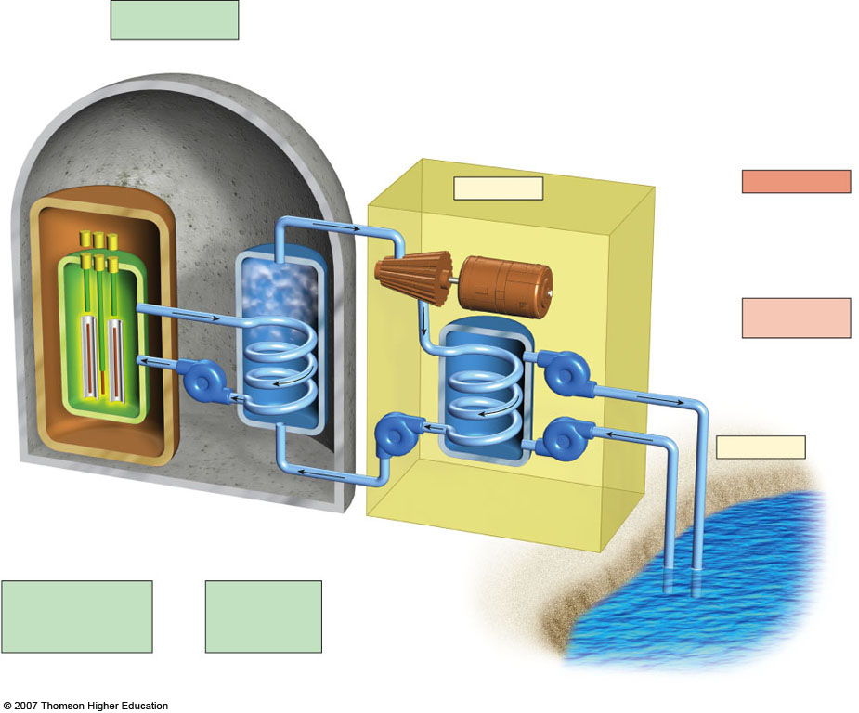
Small amounts of radioactive gases
Uranium fuel input (reactor core)
Control rods
Containment shell
Heat exchanger
Steam
Turbine
Generator
Electric power
Waste heat
Hot coolant
Useful energy 25%–30%
Hot water output
Pump
Pump
Coolant
Pump
Pump
Waste heat
Cool water input
Moderator
Shielding
Pressure vessel
Coolant passage
Water
Condenser
Periodic removal and storage of radioactive wastes and spent fuel assemblies
Periodic removal and storage of radioactive liquid wastes
Water source (river, lake, ocean)
Fig. 16-16, p. 372
Notes:
Figure 16.16
Science: light-water–moderated and –cooled nuclear power plant with a pressurized water reactor. QUESTION: How does this plant differ from the coal-burning plant in Figure 16-13?

Slide 41
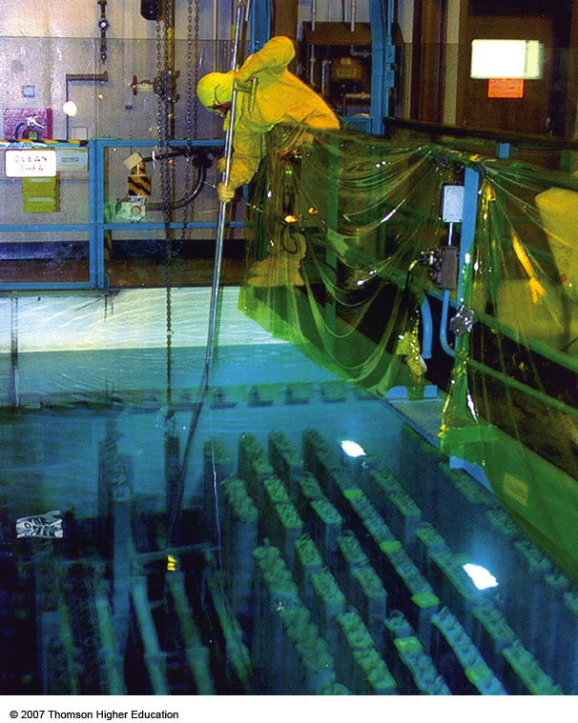
NUCLEAR ENERGY
After three or four years in a reactor, spent fuel rods are removed and stored in a deep pool of water contained in a steel-lined concrete container.
Figure 16-17

Slide 42
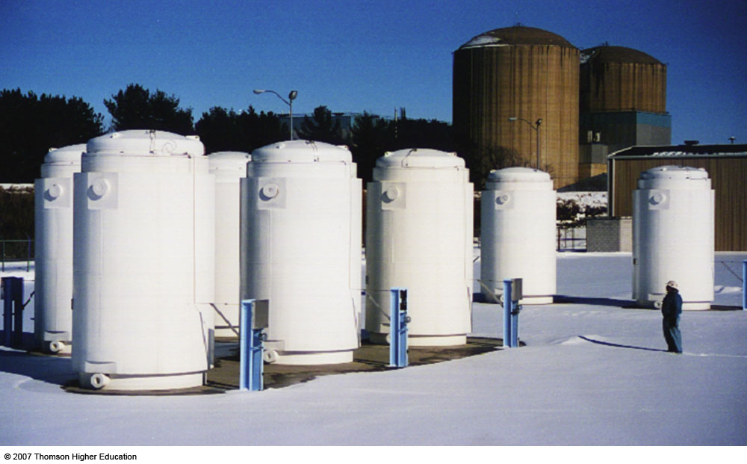
NUCLEAR ENERGY
After spent fuel rods are cooled considerably, they are sometimes moved to dry-storage containers made of steel or concrete.
Figure 16-17

Slide 43
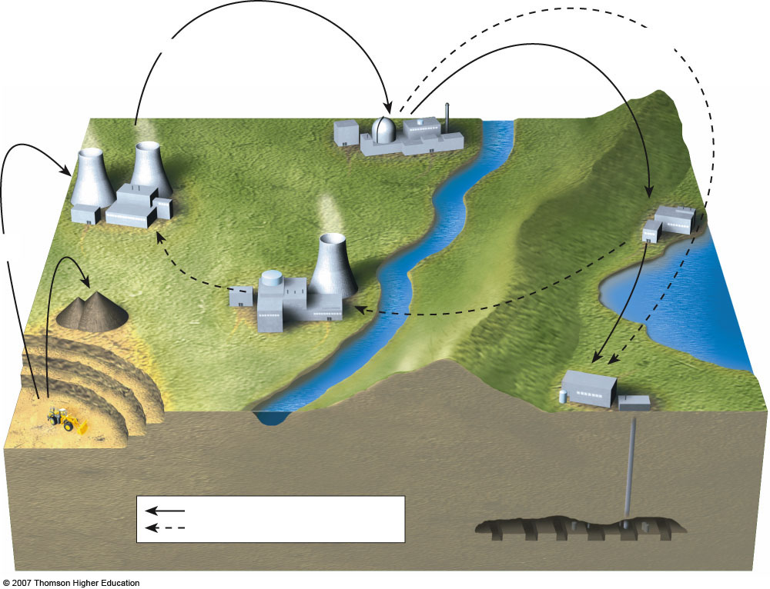
Fuel assemblies
Decommissioning of reactor
Enrichment of UF₆
Reactor
Fuel fabrication
(conversion of enriched UF₆ to UO₂ and fabrication of fuel assemblies)
Temporary storage of spent fuel assemblies underwater or in dry casks
Conversion of U₃O₈ to UF₆
Uranium-235 as UF₆ Plutonium-239 as PuO₂
Spent fuel reprocessing
Low-level radiation with long half-life
Geologic disposal of moderate & high-level radioactive wastes
Open fuel cycle today
“Closed” end fuel cycle
Fig. 16-18, p. 373
Notes:
Figure 16.18
Science: the nuclear fuel cycle. QUESTION: Are any parts of the nuclear fuel cycle within 27 kilometers (17 miles) of where you live or go to school?

Slide 44
What Happened to Nuclear Power?
After more than 50 years of development and enormous government subsidies, nuclear power has not lived up to its promise because:
Multi billion-dollar construction costs.
Higher operation costs and more malfunctions than expected.
Poor management.
Public concerns about safety and stricter government safety regulations.

Slide 45
Case Study: The Chernobyl Nuclear Power Plant Accident
The world’s worst nuclear power plant accident until recently occurred in 1986 in Ukraine.
The disaster was caused by _______ _______ _______ and _______ _______.
By 2005, 56 people had died from radiation released.
4,000 more are expected from thyroid cancer and leukemia.

Slide 46
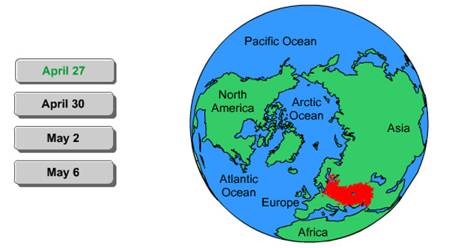
Animation: Chernobyl Fallout
PLAY
ANIMATION

Slide 47
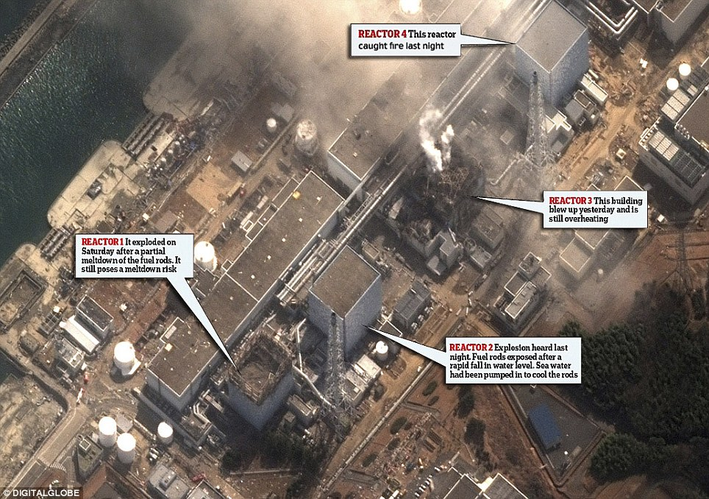
Japan's Nuclear Power Plant Disaster
http://www.dailymail.co.uk/news/article-1366341/Japan-tsumani-earthquake-America-nuclear-accident-radiation-alert.html

Slide 48
NUCLEAR ENERGY
In 1995, the World Bank said nuclear power is too costly and risky.
In 2006, it was found that several U.S. reactors in New York and New Mexico were leaking radioactive tritium into groundwater.
Figure 16-19

Slide 49
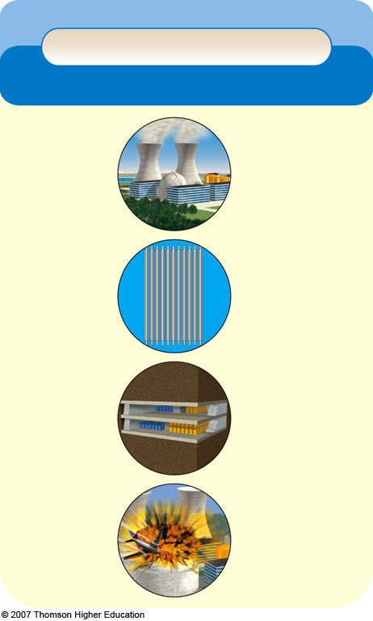
Trade-Offs
Conventional Nuclear Fuel Cycle
Advantages
Disadvantages
Large fuel supply
Cannot compete economically without huge government subsidies
Low environmental impact (without accidents)
Low net energy yield
High environmental impact (with major accidents)
Emits 1/6 as much CO₂ as coal
Moderate land disruption and water pollution (without accidents)
Catastrophic accidents can happen (Chernobyl)
No widely acceptable solution for long-term storage of radioactive wastes and decommissioning worn-out plants
Moderate land use
Low risk of accidents because of multiple safety systems (except for 15 Chernobyl-type reactors)
Subject to terrorist attacks
Spreads knowledge and technology for building
nuclear weapons
Fig. 16-19, p. 376
Notes:
Figure 16.19
Trade-offs: advantages and disadvantages of using the conventional nuclear fuel cycle (Figure 16-18) to produce electricity. QUESTION: Which single advantage and which single disadvantage do you think are the most important?

Slide 50
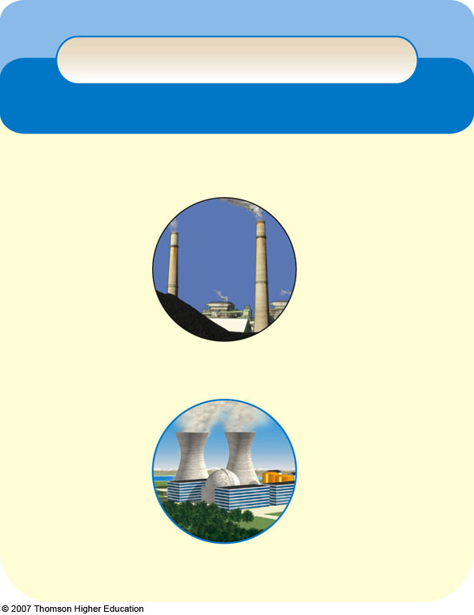
Trade-Offs
Coal vs. Nuclear
Coal
Nuclear
Ample supply
Ample supply of uranium
High net energy yield
Low net energy yield
Low air pollution (mostly from fuel reprocessing)
Very high air pollution
High CO₂ emissions
Low CO₂ emissions (mostly from fuel reprocessing)
High land disruption from surface mining
Much lower land disruption from surface mining
High land use
Moderate land use
Low cost (with huge subsidies)
High cost (even with
huge subsidies)
Fig. 16-20, p. 376
Notes:
Figure 16.20
Trade-offs: comparison of the risks of using nuclear power and coal-burning plants to produce electricity. A 1,000-megawatt nuclear plant is refueled once a year, whereas a coal plant of the same size requires 80 rail cars of coal a day. QUESTION: If you had to, would you rather live next door to a coal-fired power plant or a nuclear power plant? Explain.

Slide 51
Published: February 9, 2012
Federal Regulators Approve Two Nuclear Reactors in Georgia
WASHINGTON — The Nuclear Regulatory Commission voted 4 to 1 on Thursday to grant a license to build and operate two reactors at a nuclear plant in Georgia, a crucial threshold for an industry that has not had a new start since 1978.

Slide 52
NUCLEAR ENERGY
When a nuclear reactor reaches the end of its useful life, its highly radioactive materials must be kept from reaching the environment for thousands of years.
At least 228 large commercial reactors worldwide (20 in the U.S.) are scheduled for retirement by 2012.
Many reactors are applying to extend their 40-year license to 60 years.
Aging reactors are subject to embrittlement and corrosion.

Slide 53
NUCLEAR ENERGY
Scientists disagree about the best methods for long-term storage of high-level radioactive waste:
Bury it deep underground.
Shoot it into space.
Bury it in the Antarctic ice sheet.
Bury it in the deep-ocean floor that is geologically stable.
Change it into harmless or less harmful isotopes.

Slide 54
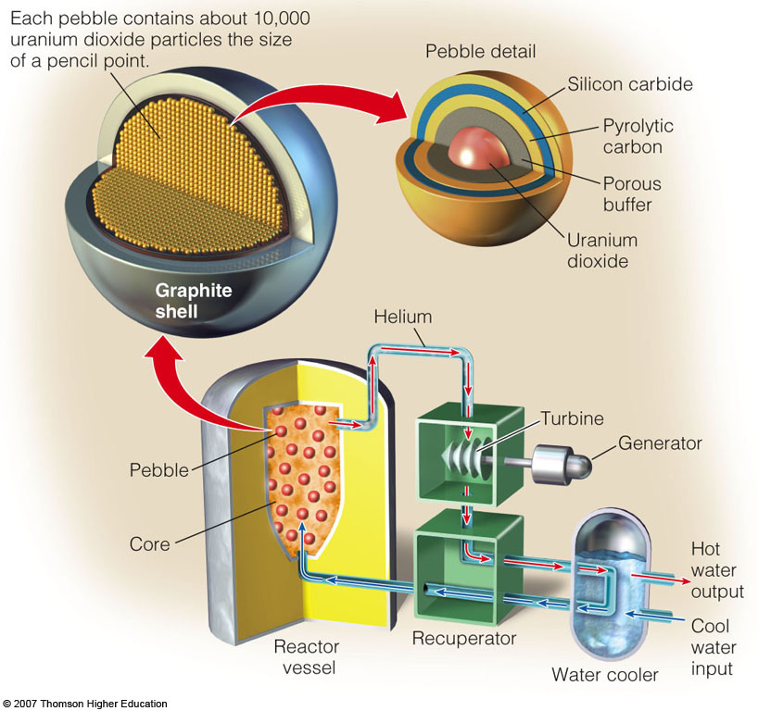
New and Safer Reactors
Pebble bed modular reactor (PBMR) are smaller reactors that minimize the chances of runaway chain reactions by encapsulating uranium furls in tiny heat-resistant ceramic spheres.
Figure 16-21

Slide 55
NUCLEAR ENERGY
Nuclear _________ is a nuclear change in which two isotopes are forced together.
No risk of meltdown or radioactive releases.
May also be used to breakdown toxic material.
Still in laboratory stages.

