Slide 1
CELL TRANSPORT

Slide 2
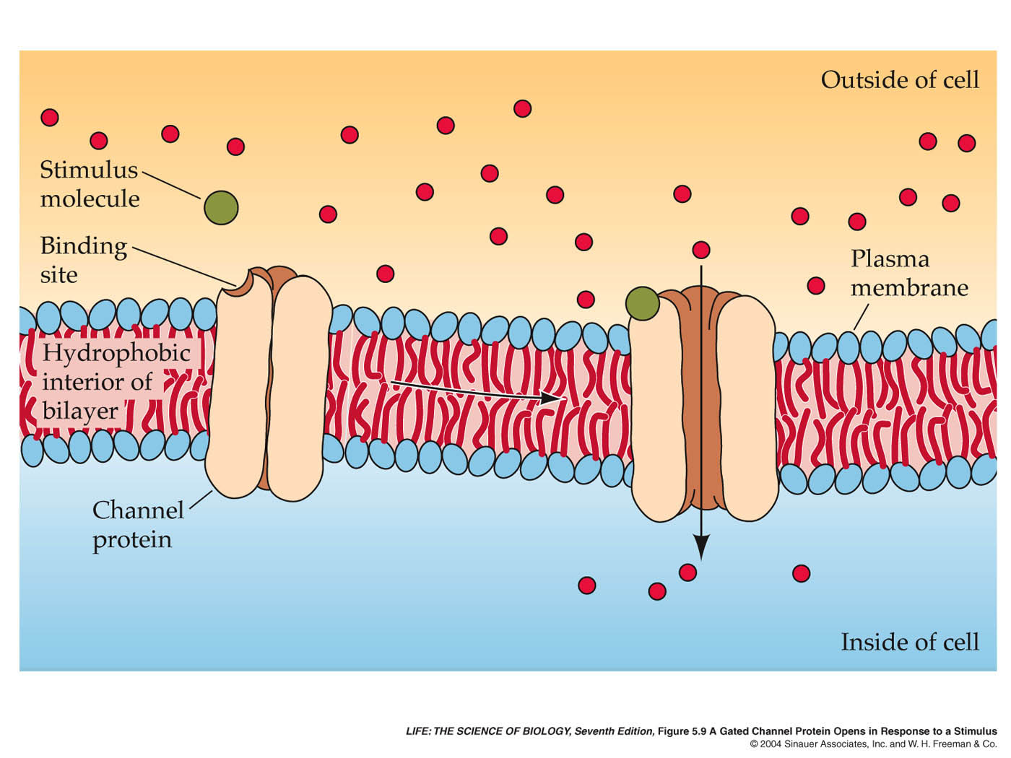
A Channel Protein Opens in Response to a Stimulus

Slide 3
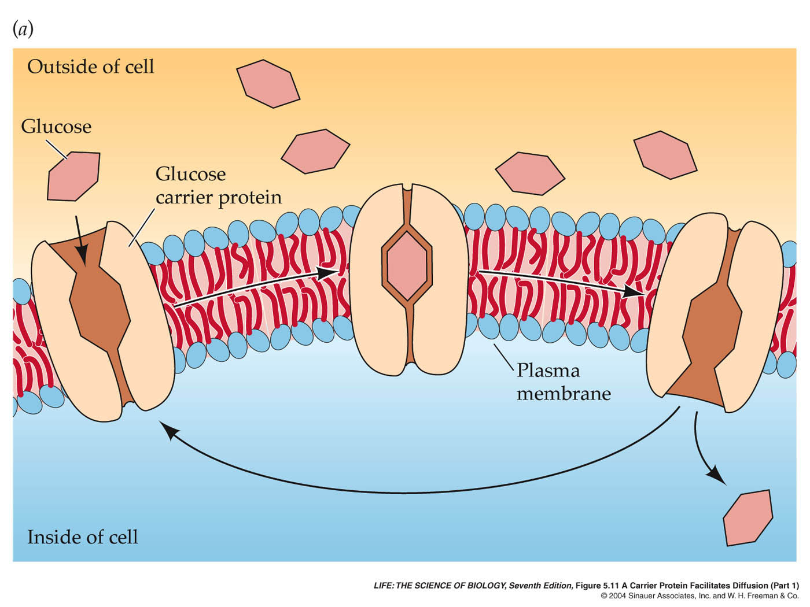
A Channel Protein Facilitates Diffusion of Glucose

Slide 4
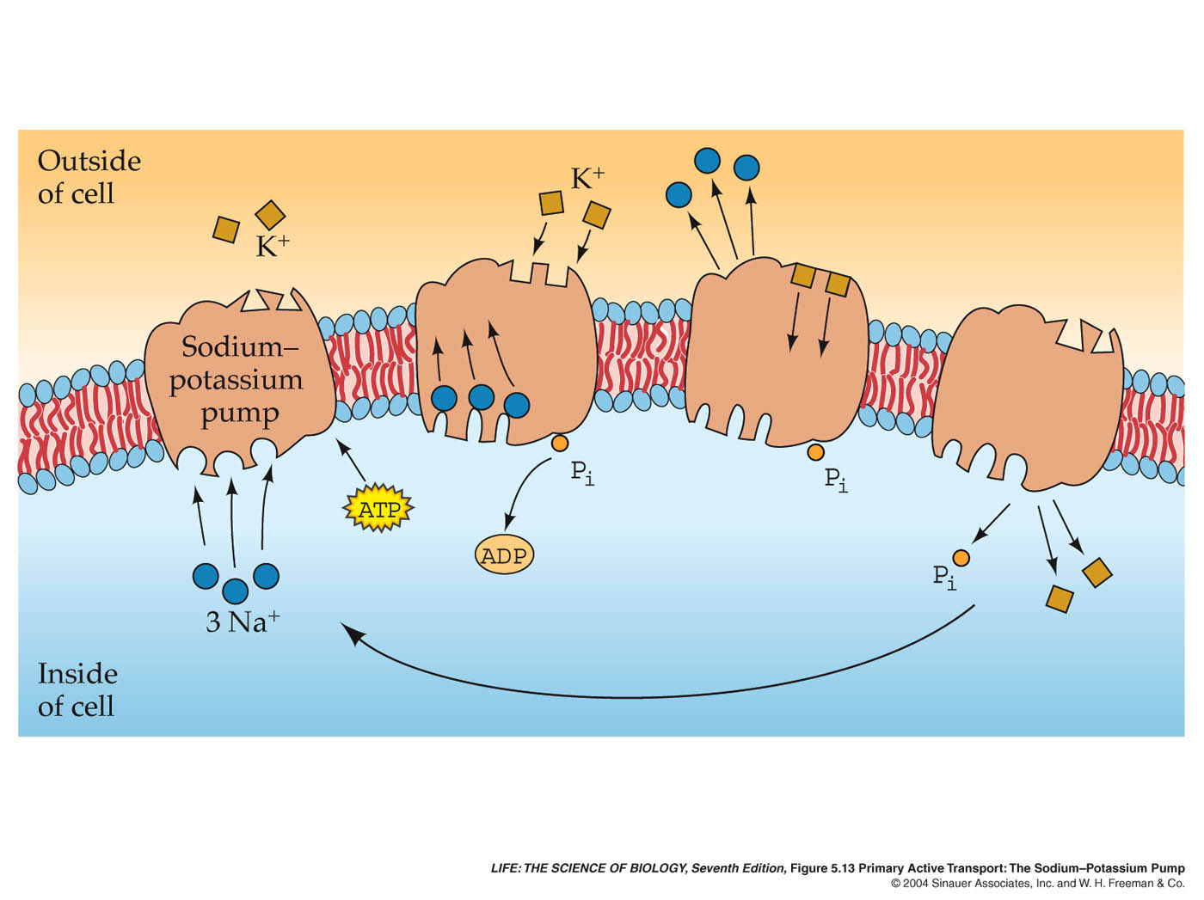
Active Transport: The Sodium–Potassium Pump

Slide 5
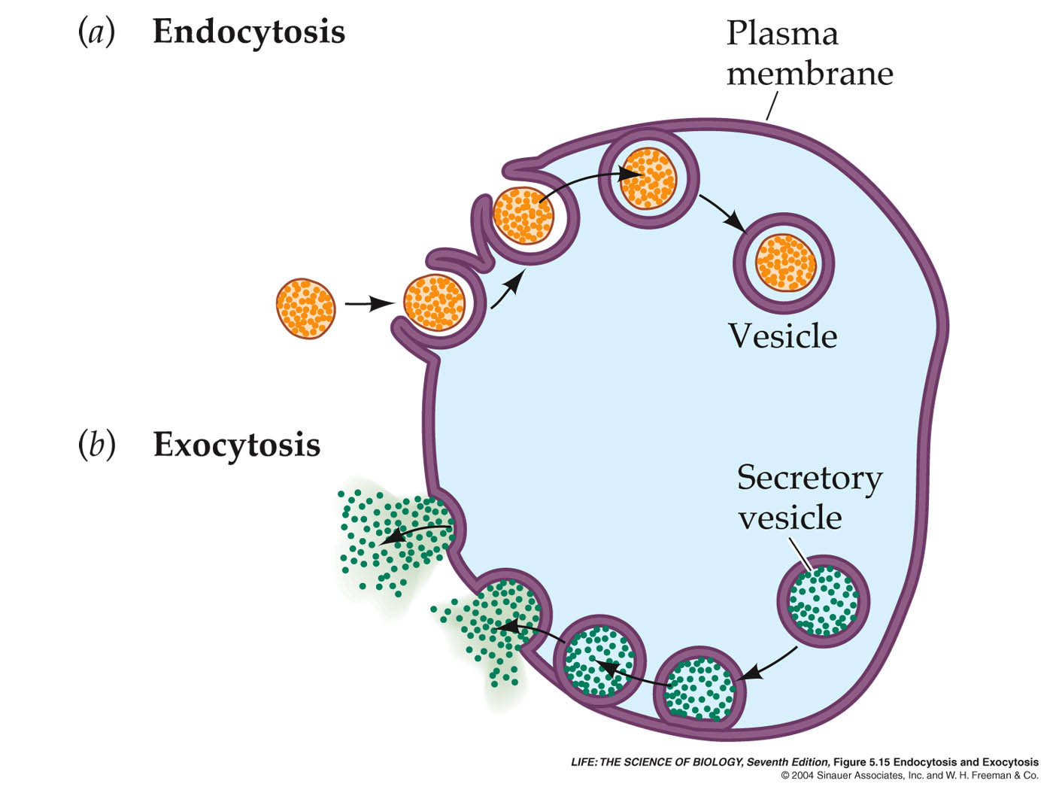
Endocytosis and Exocytosis
Phago- “eat”
Pino- “drink”
Receptor mediated
-CHOLESTEROL

Slide 6
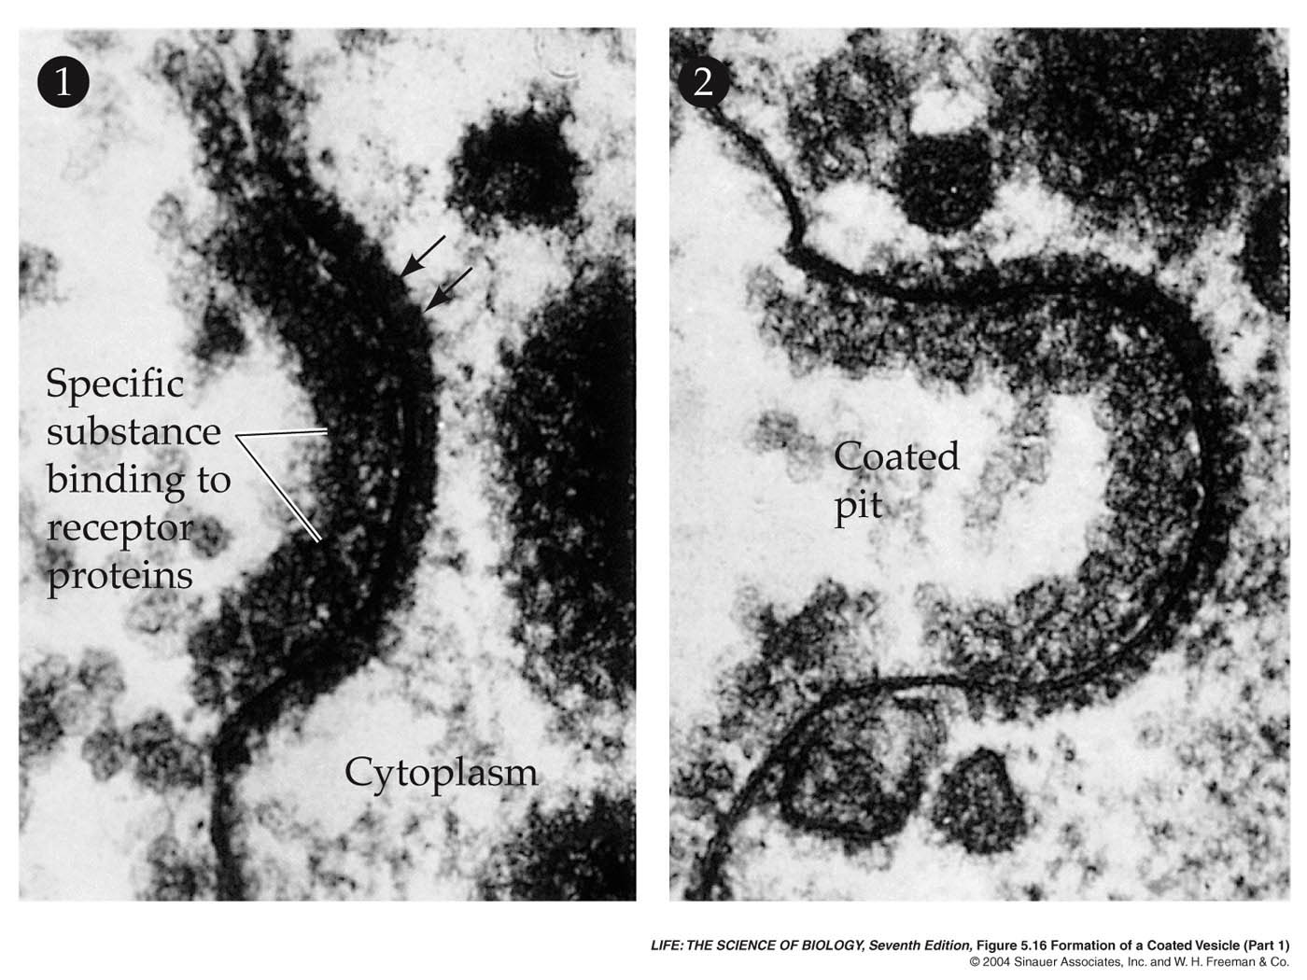
Formation of a Coated Vesicle

Slide 7
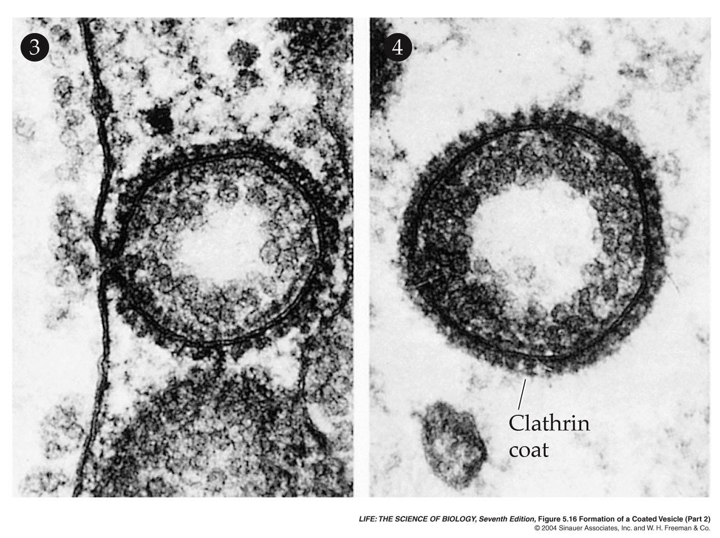
Formation of a Coated Vesicle

