Slide 1
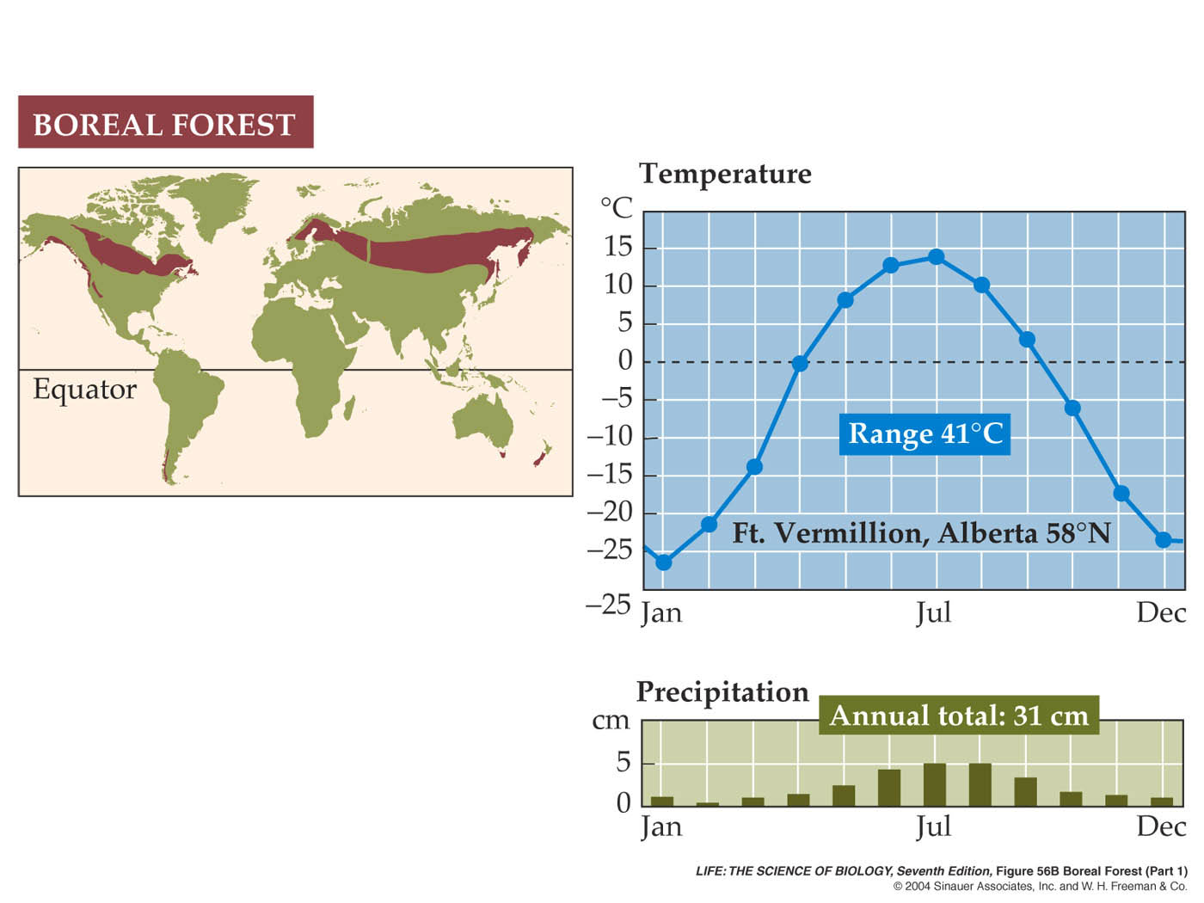
Biomes: Boreal Forest (Part 1)

Slide 2
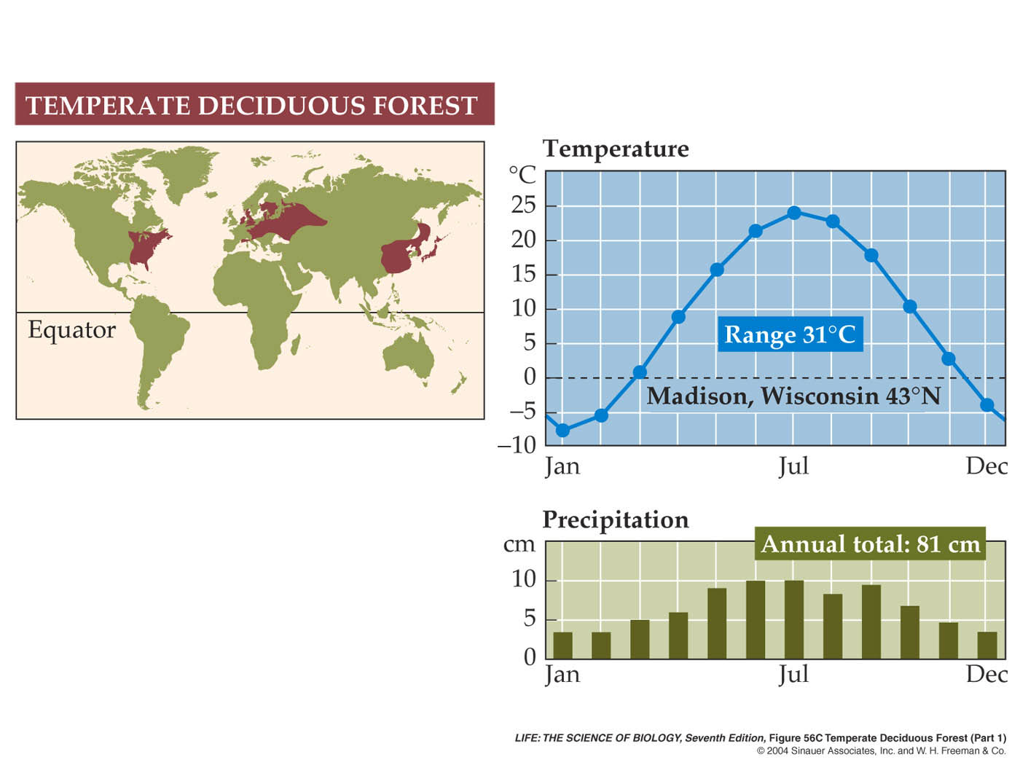
Biomes: Temperate Deciduous Forest (Part 1)

Slide 3
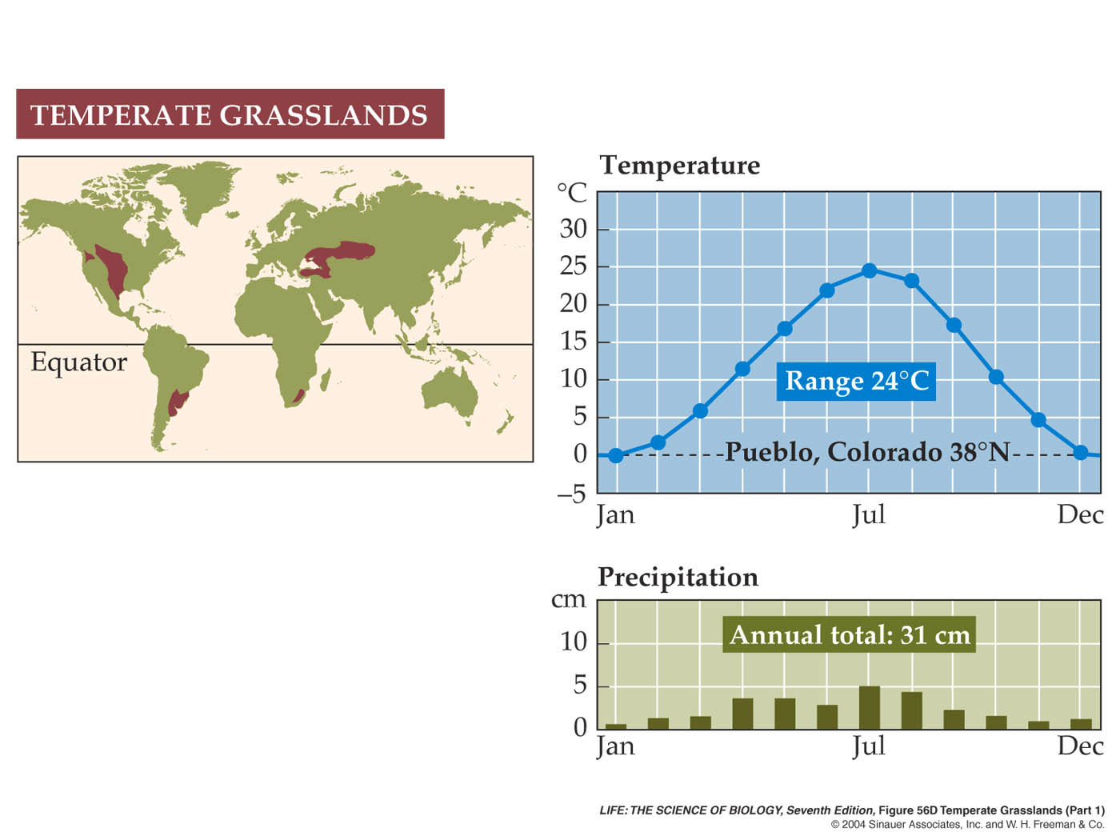
Biomes: Temperate Grasslands (Part 1)

Slide 4
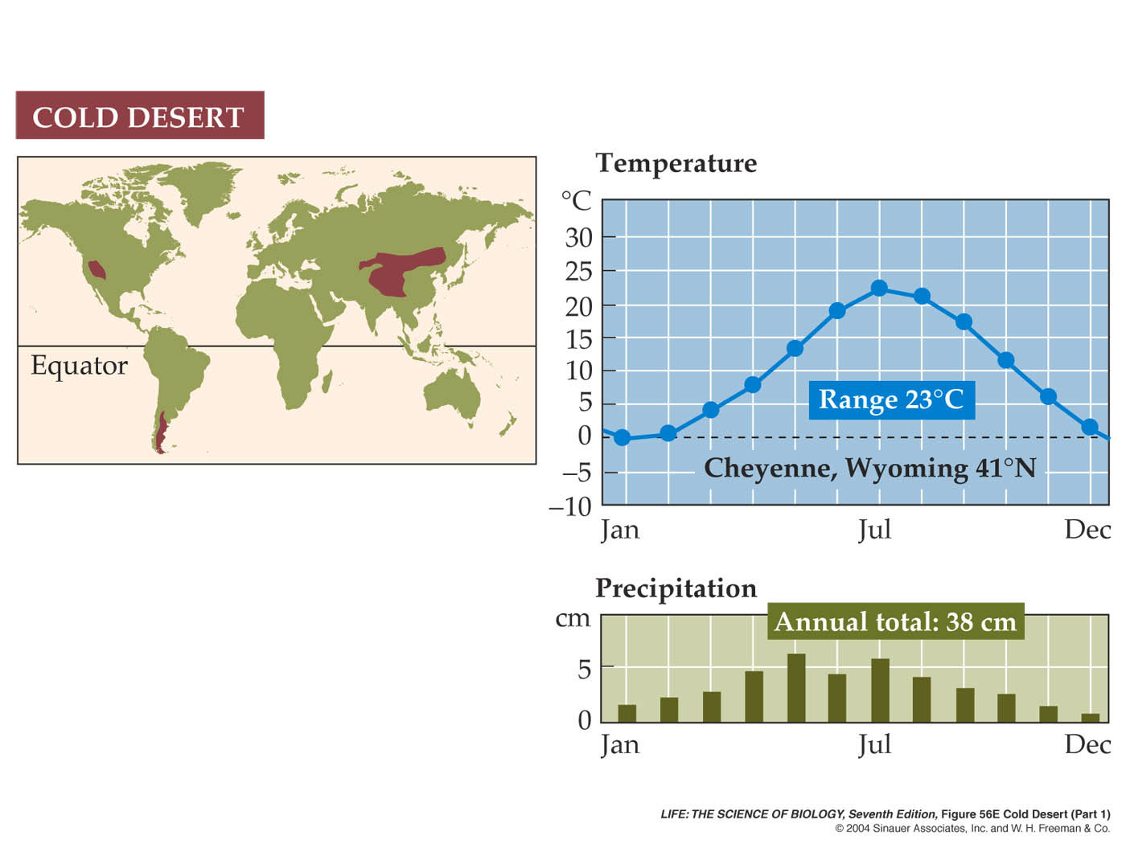
Biomes: Cold Desert (Part 1)

Slide 5
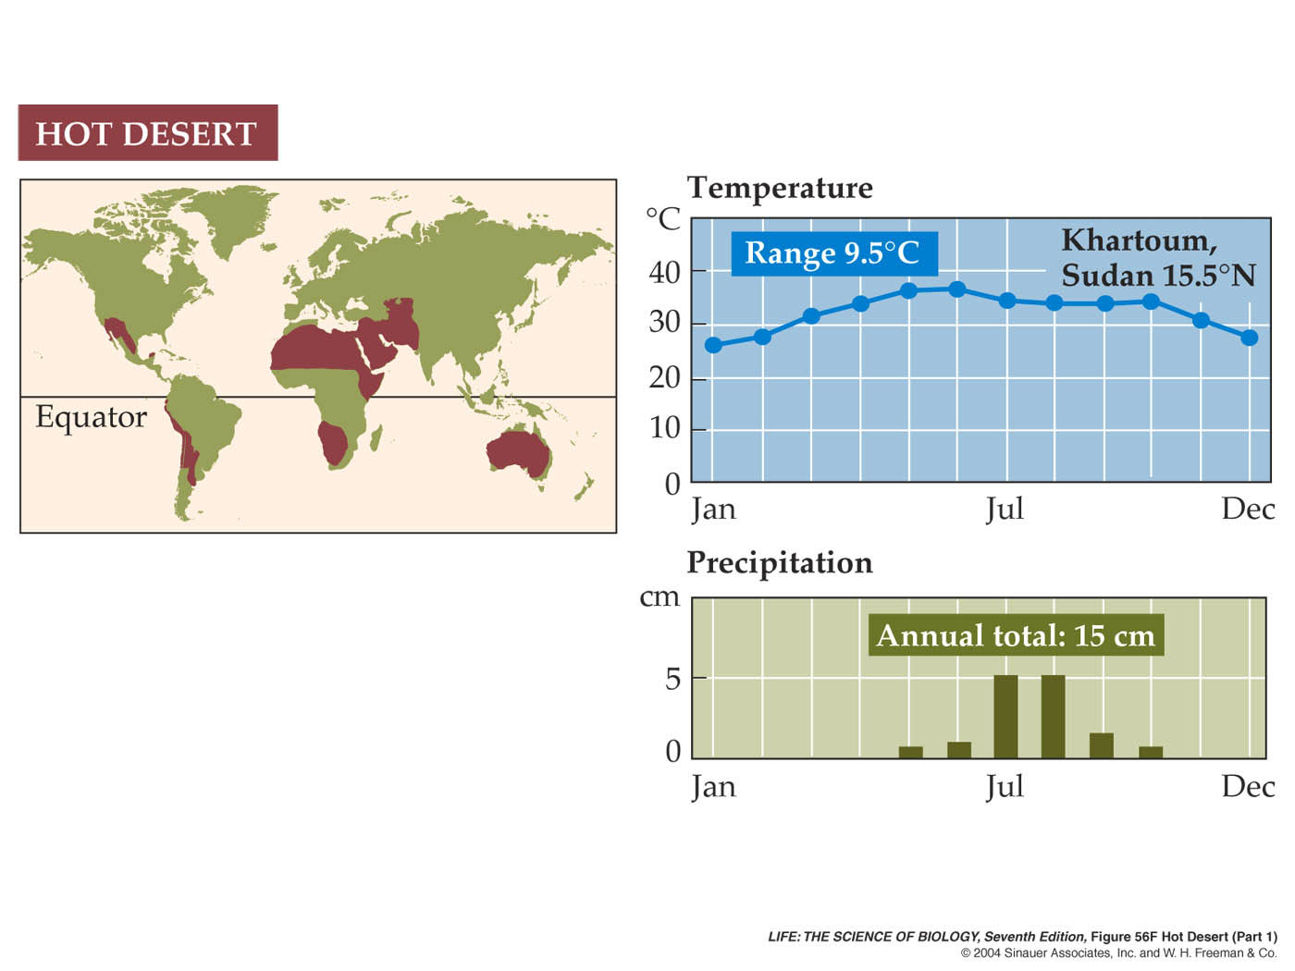
Biomes: Hot Desert (Part 1)

Slide 6
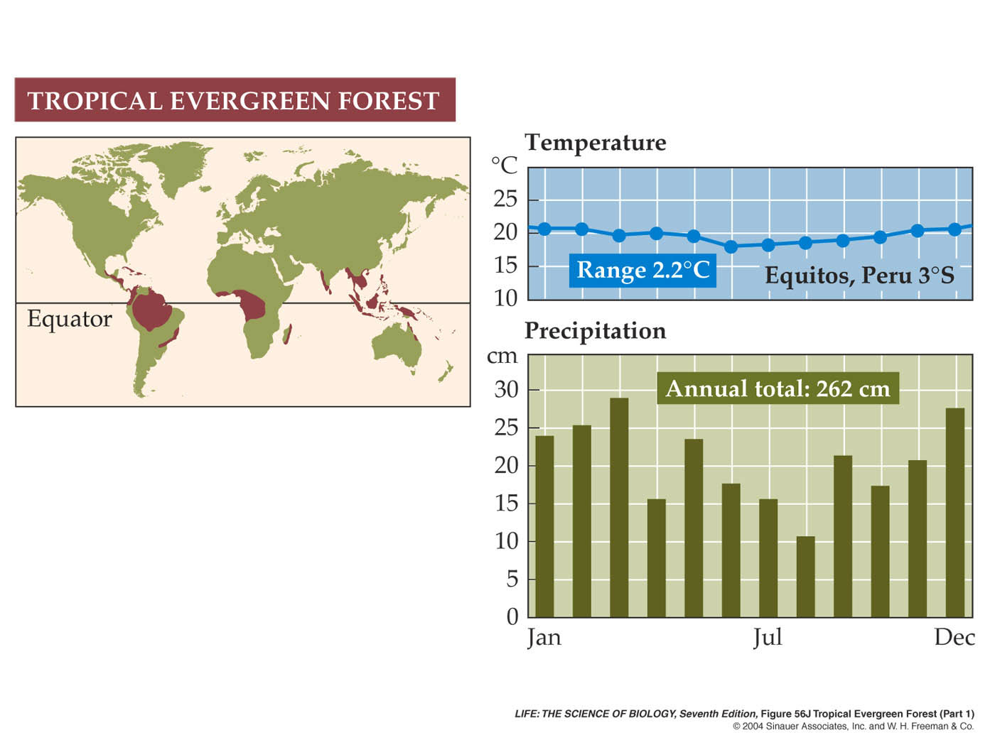
Biomes: Tropical Evergreen Forest (Part 1)

